Slide 1
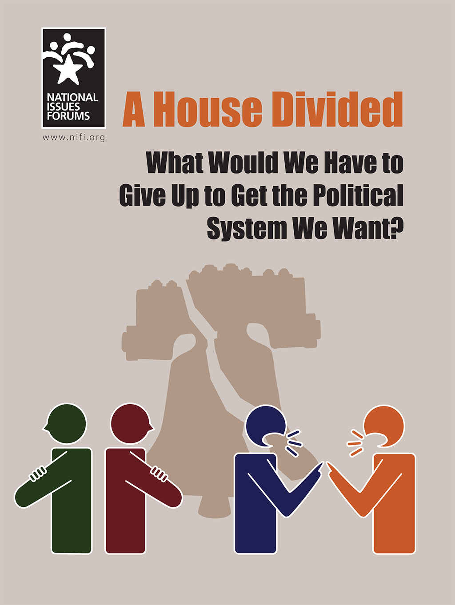
WELCOME
National Issues Forums
on
A House Divided
[insert date]

Slide 2
Holding a Deliberative Forum
1. Introduction
2. Connect to Issue
3. Consider Each Option
4. Review and Reflect
Review ground rules.
Introduce the issue.
Ask people to describe how the issue affects them, their families, or friends.
Consider each option one at a time.
Allow equal time for each.
What is attractive?
What about the drawbacks?
Review the conversation as a group.
What areas of common ground were apparent?
What tensions and trade-offs were most difficult?
Whom else do we need to hear from?

Slide 3
Ground Rules for a Forum
Focus on the options and actions we can take nationally and in our communities.
Consider all options fairly.
Listening is just as important as speaking.
No one or two individuals should dominate.
Maintain an open and respectful atmosphere.
Everyone is encouraged to participate.

Slide 4
_{Discussion Starter Video}
_{https://vimeo.com/319080343}

Slide 5
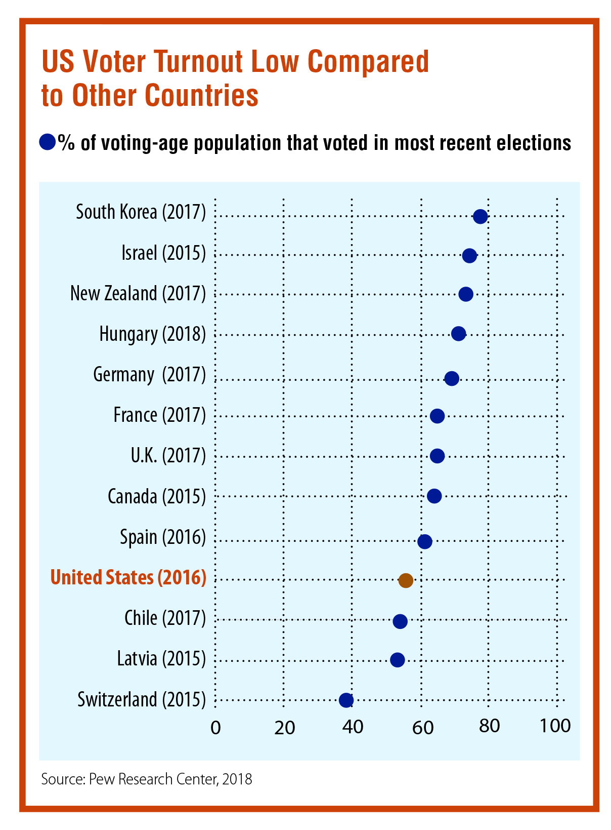

Slide 6
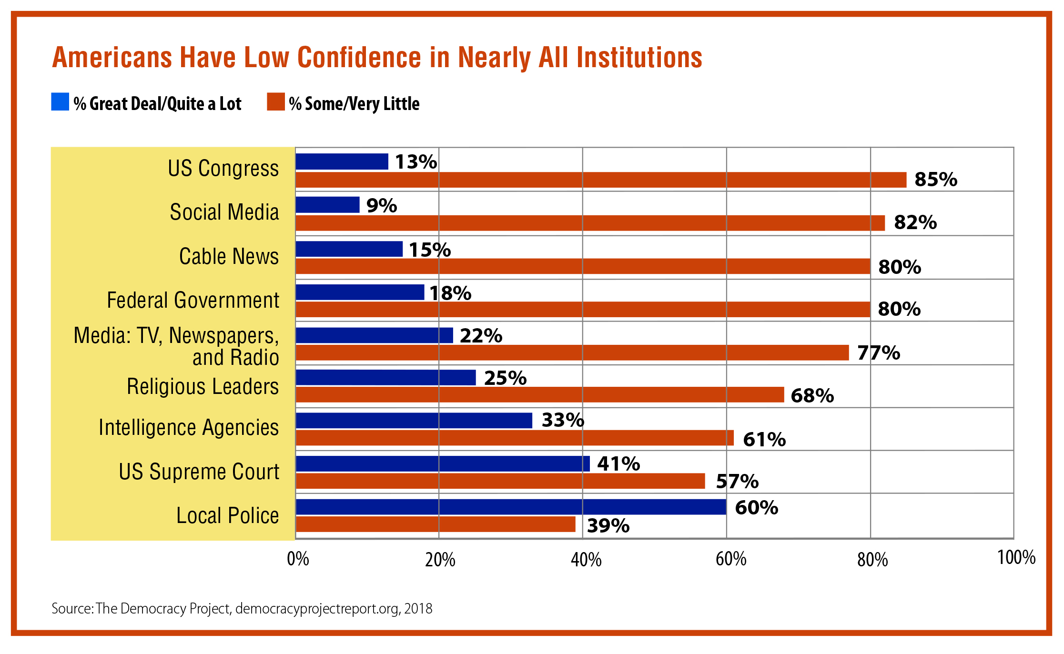

Slide 7

OPTION 1:
Reduce Dangerous, Toxic Talk
The problem is that the way we talk is poisoning public life. The “outrage industry” rewards people for saying and doing the most extreme things.
Public figures vie for attention on TV and online.
Fringe groups feel empowered to spread their hate and conspiracy theories.
The lines between news, opinion, and entertainment are erased. We don’t know whom to believe anymore. And if people say the “wrong thing,” they are attacked because they were not “politically correct.”
News networks and social media must do much more to control hate speech. We need to stop rewarding outrage and bring back common sense.
A Primary Drawback
  This gives media and internet decision-makers enormous power to determine what people can say about each other or about public issues. Who gets to decide what’s “outrageous” and what’s not?

Slide 8
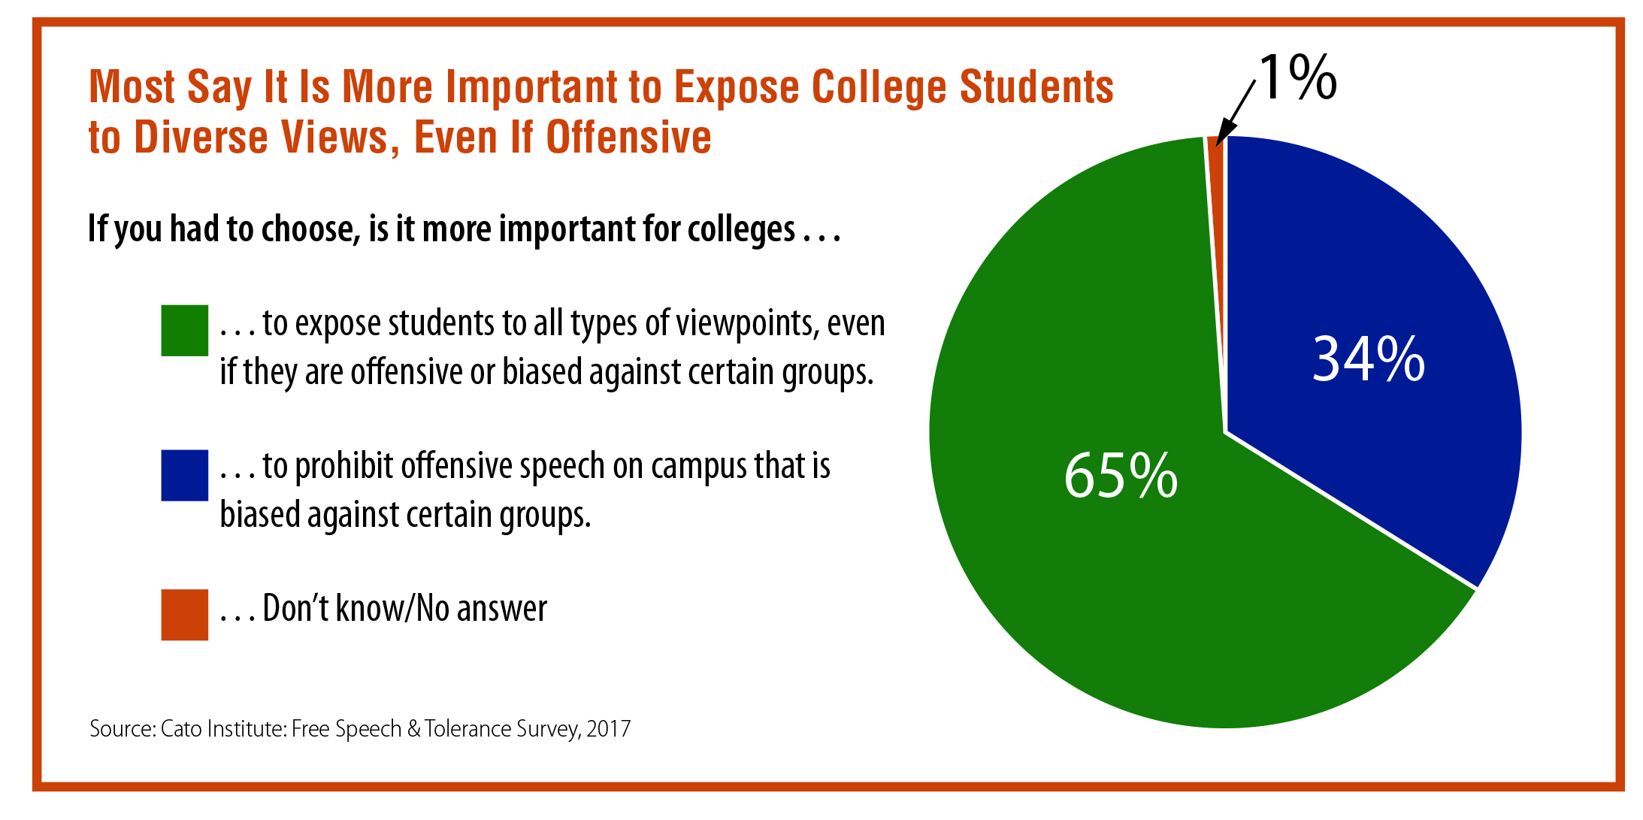

Slide 9
Option 1: Reduce Dangerous, Toxic Talk
Possible Actions
Drawbacks
Facebook and other social media platforms and internet service providers should kick out users who use slurs or profanity or threaten physical violence.
Internet companies could become the “language police,” threatening people’s right to express themselves freely.
Require all television networks to provide opposing views on controversial issues.
This reduces complex debates to “pro” and “con” voices and means that important voices may never be heard.
Make websites and television stations liable for allowing ads that make unproven or false charges about political candidates.
This would unleash a flood of lawsuits from every frustrated politician.
Protect freedom of speech on college campuses by protecting professors, students, and speakers who espouse unpopular or “politically incorrect” views.
Students can’t learn and thrive in a disrespectful atmosphere where they feel threatened and undermined.
What else?
The trade-off?

Slide 10
1
Curtailing free speech harms our democracy. But doesn’t abusive, dishonest political rhetoric do the same thing when it drives people away from politics? What’s the right balance here?
OPTION 1
Questions for deliberation
2
The “outrage industry” continues because it’s popular—it boosts TV ratings and increases clicks online. Is there any practical way to encourage users to behave more responsibly?
3
People with all kinds of political views engage in name-calling and abusive behavior. Do we object only when it’s someone with whom we disagree?

Slide 11
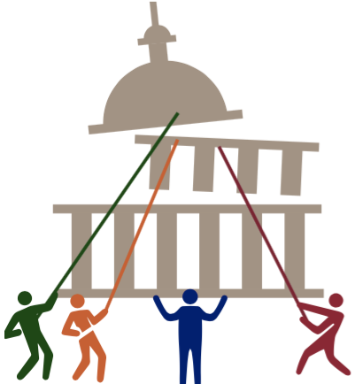
OPTION 2:
Make Fairer Rules for Politics and Follow Them
The problem is that wealthy, powerful special interests game the political system, making it impossible to find compromise.
Candidates play to their bases rather than trying to reach a broader range of people.
The flood of money into campaigns and lobbying gives too much power to special interests.
The major political parties redraw election districts to their advantage, which means more partisanship in Washington, DC.
Elected officials leave Congress and join multimillion dollar lobbying firms, giving their clients access and power not available to ordinary people.
It’s time to reduce the power of money in politics, correct the flaws in our system that reward such extreme partisanship, and restore the tradition of compromise that has served this nation well in the past.
A Primary Drawback
  This may do too much to limit the ability of Americans to fight for their principles and give too much power to those who don’t seem to care enough to vote and participate. This option focuses on compromise and changing the rules, but doesn’t our system need more fundamental changes?

Slide 12
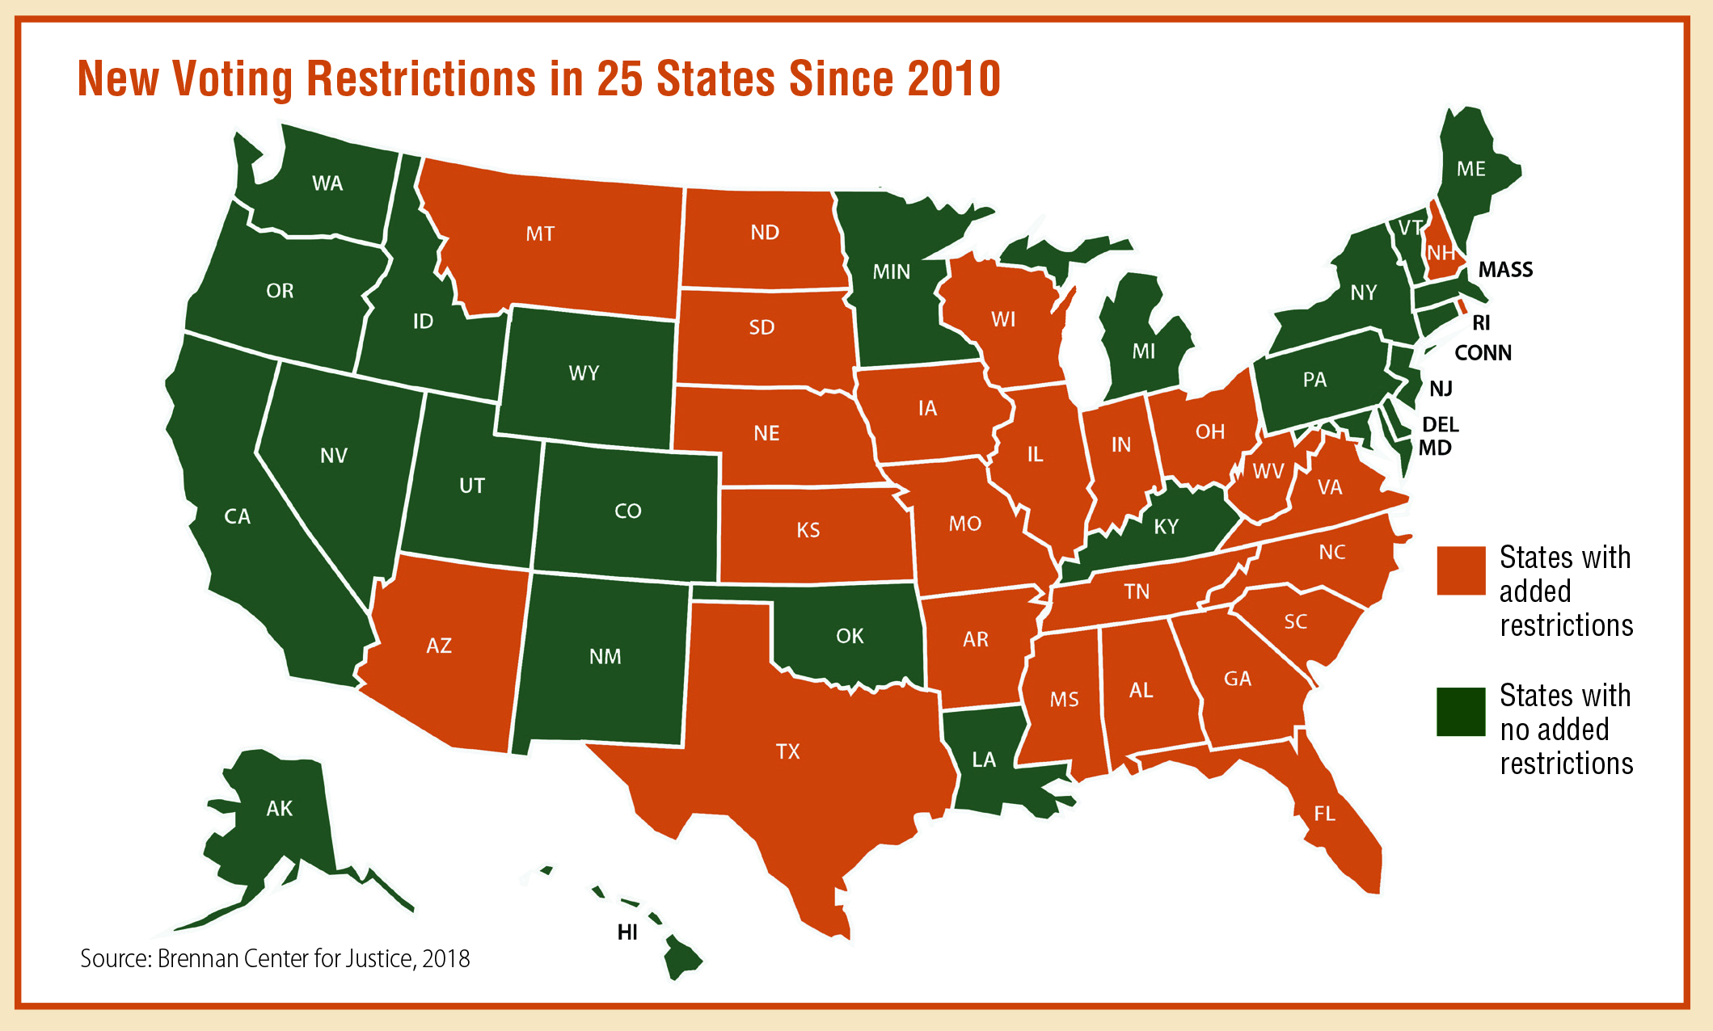

Slide 13
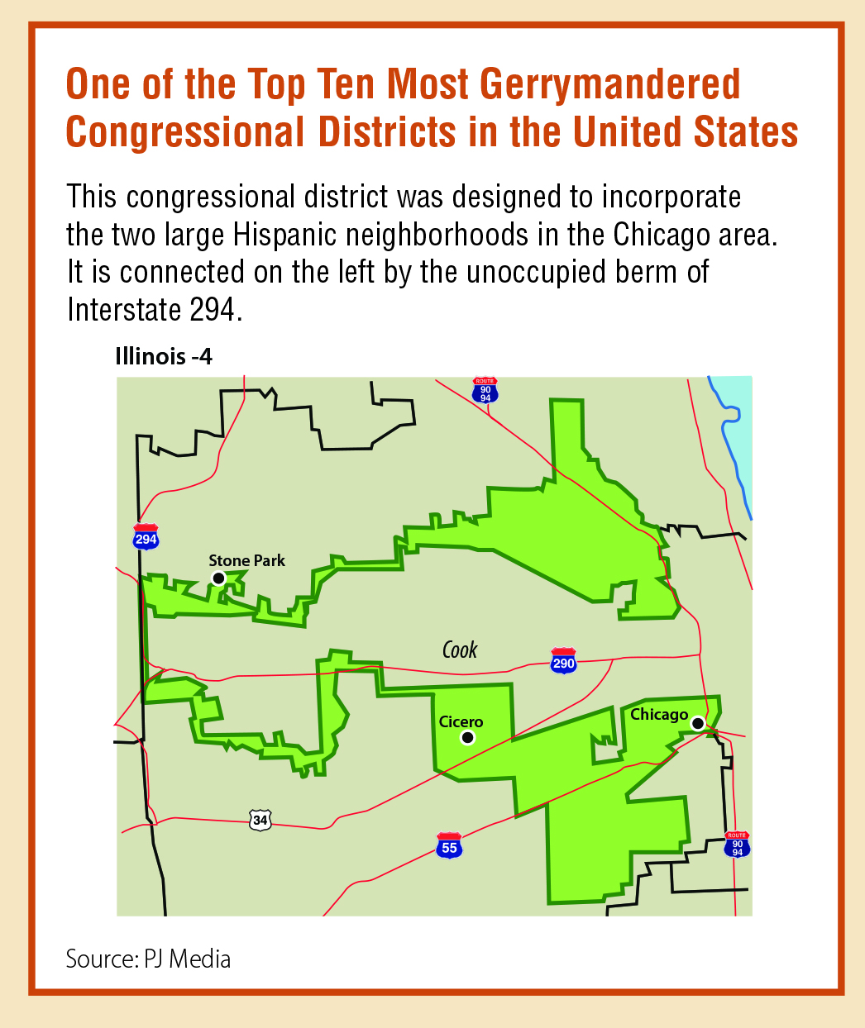

Slide 14
Option 2: Make Fairer Rules for Politics and Follow Them
Possible Actions
Drawbacks
Remove the burdensome registration and scheduling barriers that make voting difficult for so many Americans. Too many people are being shut out.
This makes voting more like a choice than the duty it is. These requirements protect us against voter fraud and manipulation.
Revise the 1965 Voting Rights Act to forbid new laws or requirements that could make it harder for minorities or poor people to vote.
Limiting requirements like showing a photo ID could leave the voting system vulnerable to manipulation or fraud.
Create nonpartisan commissions to draw election districts based on population patterns so politicians don’t design them to favor their own party.
In some legislative districts, minority groups would lose power.
Strictly limit how much outside groups and individuals can contribute to candidates and PACs, even by Constitutional amendment if necessary.
This would limit the ability of all kinds of groups and donors to participate, including those fighting for causes and candidates we ourselves support.
What else?
The trade-off?

Slide 15
1
Are the requirements for voting really so burdensome? Isn’t it reasonable to expect people to identify themselves and invest a little effort in order to vote?
OPTION 2
Questions for deliberation
2
Some of the nation’s worst decisions were the result of compromise, notably the acceptance of slavery by the Founding Fathers. Would more compromise help our country, or would it move us further away from doing what’s right?
3
Some people think we should publicly finance political campaigns. What sacrifices, such as higher taxes, would each of us be willing to make if it would reduce the influence of big money on politics?

Slide 16
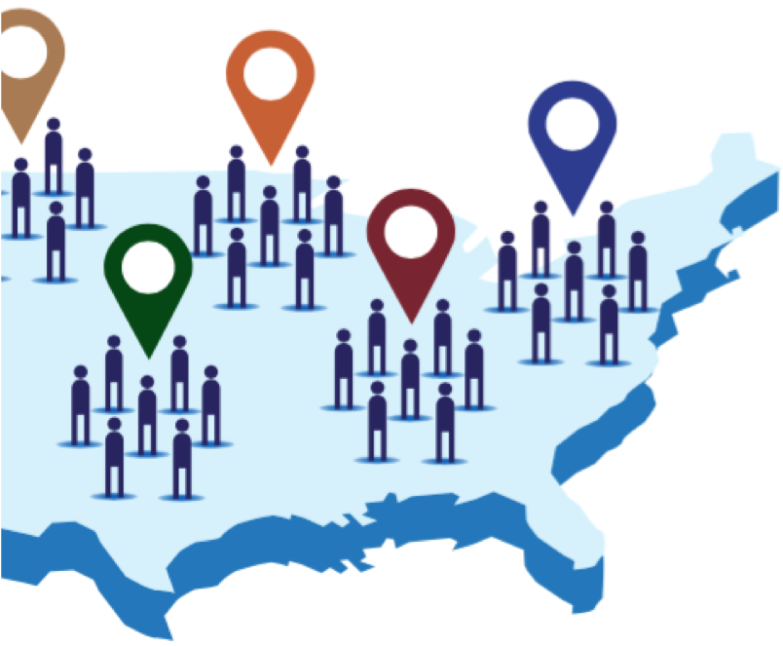
OPTION 3:
Take Control and Make Decisions Closer to Home
The problem is that our most important decisions are being made too far away from home.
When the national government is embroiled in political infighting, problems go unsolved.
It’s time to put decision-making back in the hands of people who live and work closely together, share goals and values, and can act quickly.
Communities across the nation, frustrated by inaction in Washington, already are moving to address problems they’re familiar with at the ground level.
A Primary Drawback
  This will result in different protections and standards across the country and produce a patchwork of rules on major national challenges such as infrastructure, environmental protection, and immigration. We are one country. Don’t we need a united approach to urgent problems rather than a piecemeal one?

Slide 17
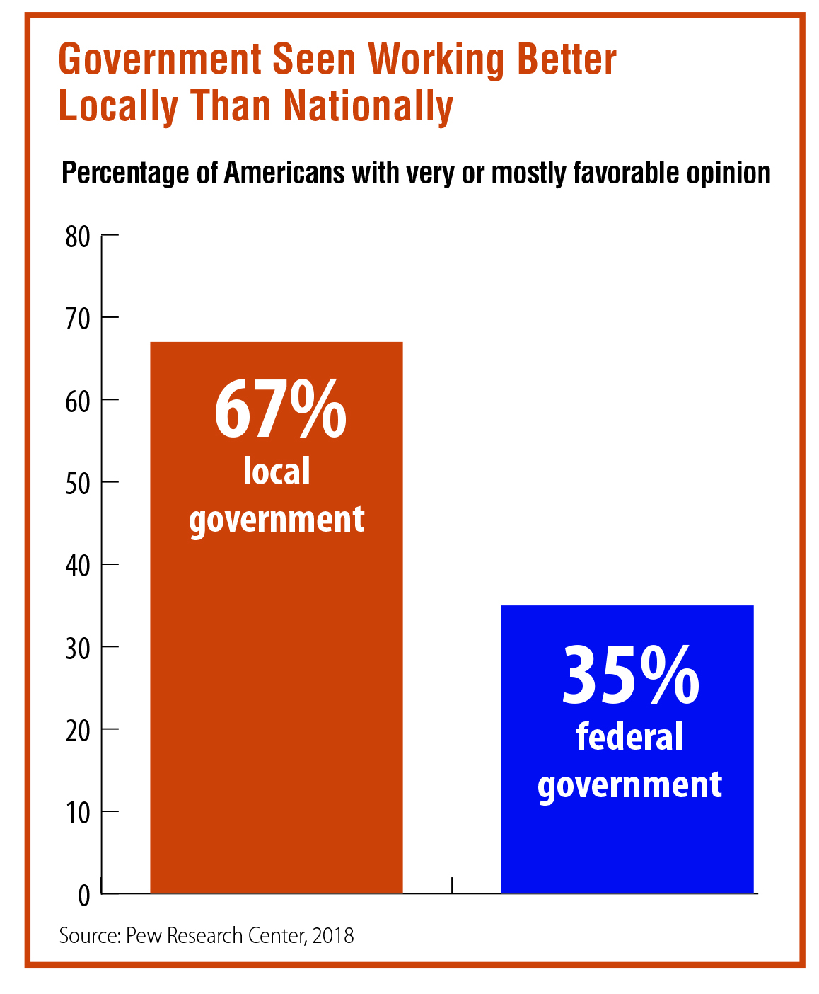

Slide 18
Option 3: Take Control and Make Decisions Closer to Home
Possible Actions
Drawbacks
Dramatically reduce cumbersome federal regulations on the environment, energy, and transportation. Local residents have a much better understanding of what their communities need.
We will never get improvements in the environment, energy, and transportation with individual states going every which way.
Give states money without restrictions for major federal programs such as Medicaid and education so states can adapt them to fit their own needs.
Basics such as food, shelter, high-quality education, and essential health care should be available to all Americans, no matter where they live. This would turn these decisions over to local politicians.
Local governments should rely much more on community groups, organizations, and churches to address issues like crime, health, and welfare.
Vulnerable Americans could suffer in communities that do not have the resources or willingness to take on these problems.
Return full control and funding of K-12 public education to local communities and the states so residents can determine what’s best for their own children.
Federal grants help schools with low-income students, and some communities may have to raise property taxes to close the gap.
What else?
The trade-off?

Slide 19
1
This option assumes that local decisions will be better decisions. But what will happen to people living in communities where local governments are biased or inept or corrupt?
OPTION 3
Questions for deliberation
2
What will happen to our country in 20 or 30 years if citizens focus mainly on local problems and issues? Isn’t this approach like giving up on our national government?
3
This option would shift more problem-solving responsibility to local communities. What role do each of us play in our neighborhoods and cities to make that work?

Slide 20
Closing Reflections
Other questions to consider—
On what do we agree?
About what do we need to talk more?
From whom else should we hear?
What else do we need to know?
How do the ideas and options in this guide affect what we do as individuals or as members of a community, and as citizens and residents in the United States as a whole?

Slide 21
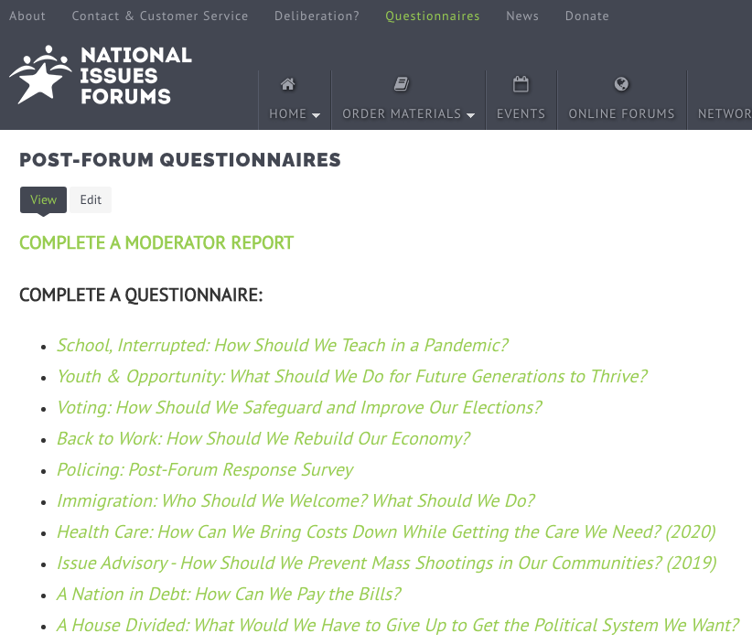
Post Forum Questionnaire
Now that you’ve had a chance to participate in a forum on this issue, we’d like to know what you’re thinking. Anonymous responses will be included in summary reports on the forums and in research to help us better understand how people are thinking about current issues.
You may fill out this questionnaire online. https://www.surveymonkey.com/r/NCKHTK3.
Thank you!

