Slide 1
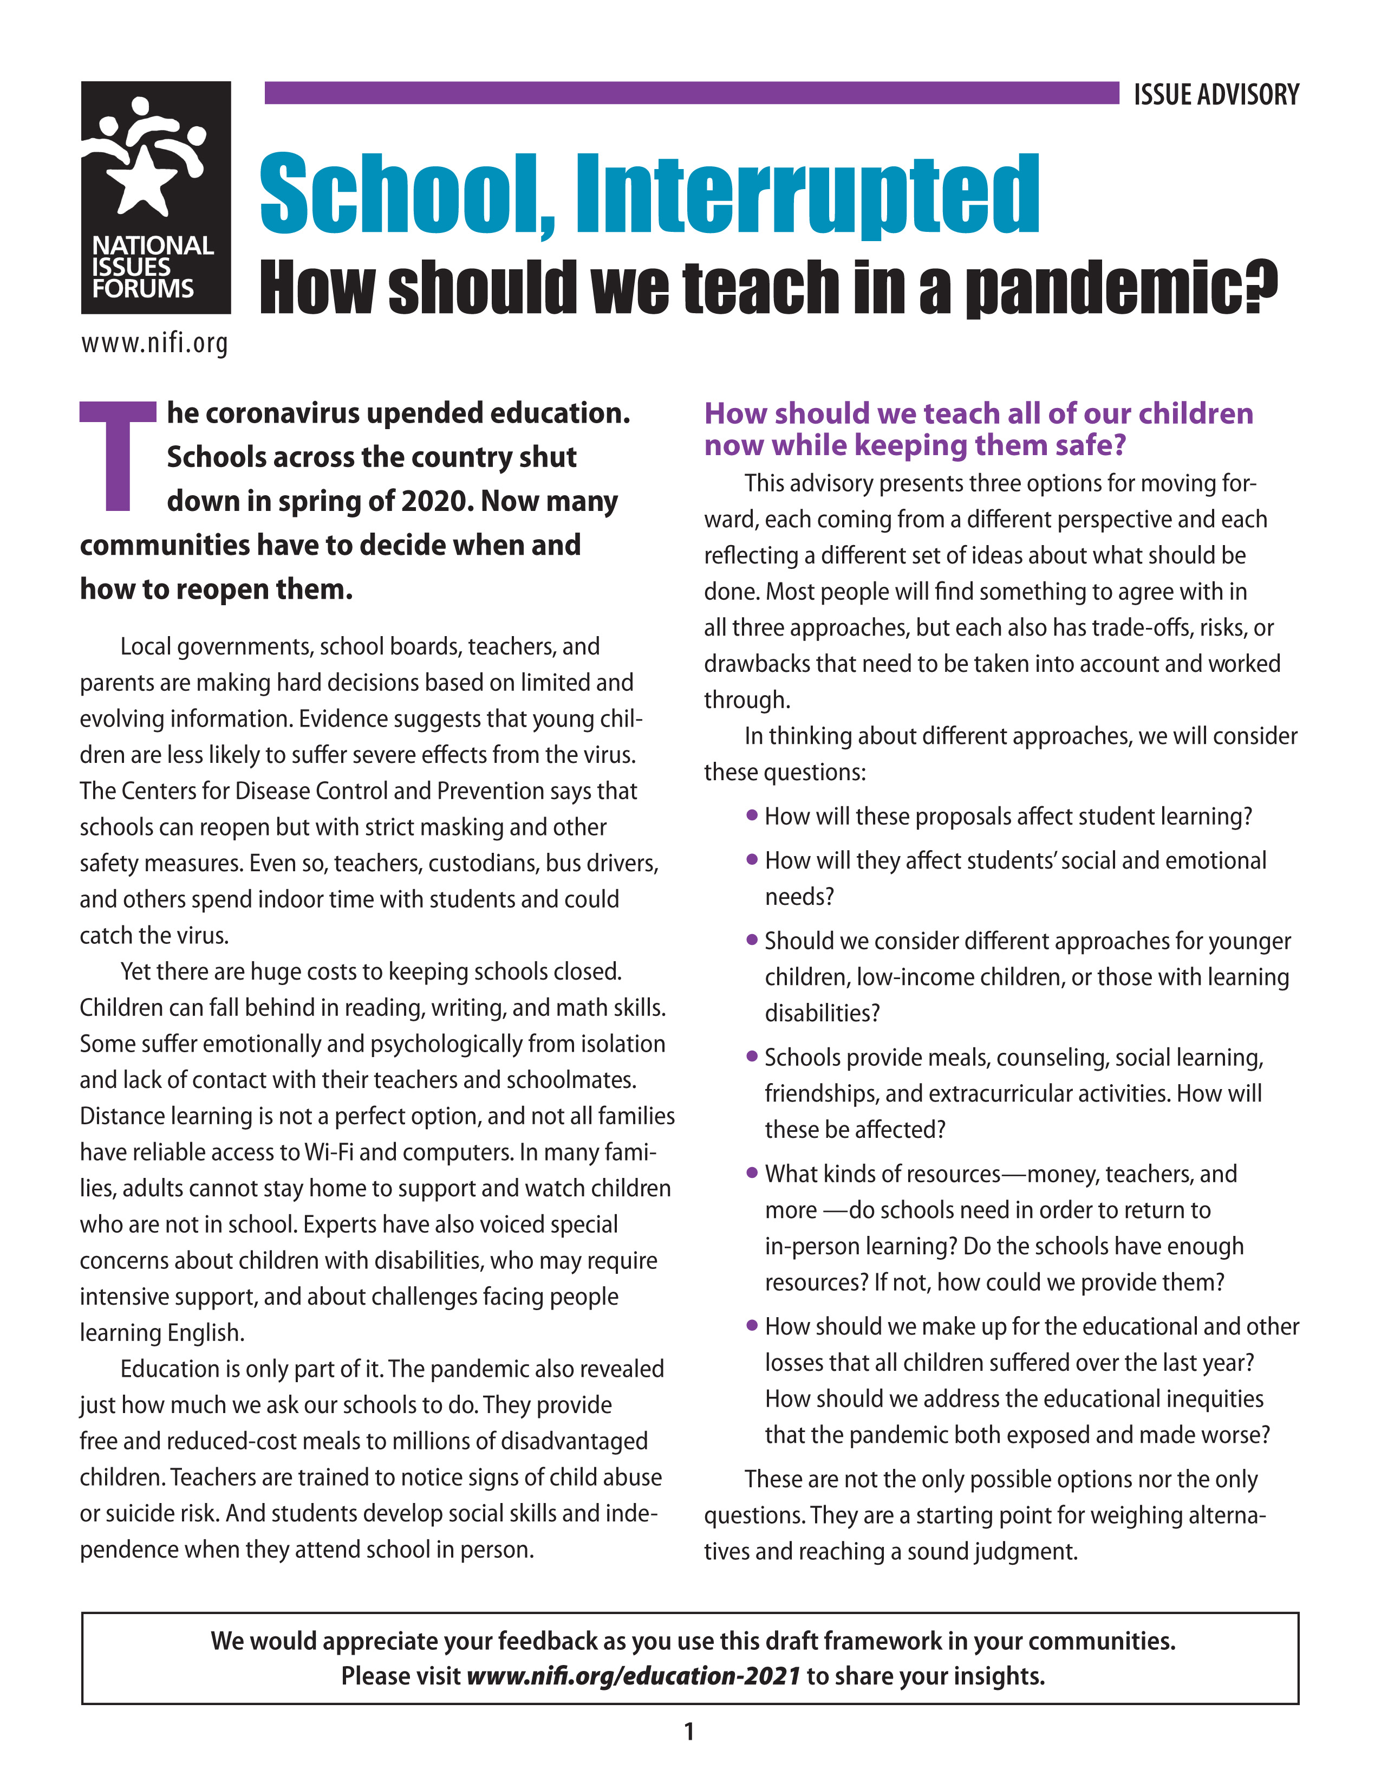
WELCOME
National Issues Forum
on
School, Interrupted
[insert date]

Slide 2
Holding a Deliberative Forum
1. Introduction
2. Connect to Issue
3. Consider Each Option
4. Review and Reflect
Review ground rules.
Introduce the issue.
Ask people to describe how the issue affects them, their families, or friends.
Consider each option one at a time.
Allow equal time for each.
What is attractive?
What about the drawbacks?
Review the conversation as a group.
What areas of common ground were apparent?
What tensions and trade-offs were most difficult?
Who else do we need to hear from?

Slide 3
Ground Rules for a Forum
Focus on the options and actions we can take nationally and in our communities.
Consider all options fairly.
Listening is just as important as speaking.
No one or two individuals should dominate.
Maintain an open and respectful atmosphere.
Everyone is encouraged to participate.

Slide 4
OPTION 1:
Put health concerns first
Even though early data about the coronavirus show that most young children are affected mildly, if at all, those with underlying conditions can fall ill or die and some may suffer long-term effects.
Teachers are at risk as well, and children could bring the virus home to parents, grandparents, and siblings.
A Primary Drawback
  Remote learning harms children educationally and emotionally, particularly those with learning disabilities or who are already struggling in school. It makes our unequal education system even more unequal as children fall behind in their studies, go hungry, or are left without adult supervision and support.
This option says that our children’s health should be our priority.

Slide 5
Option 1: Put health concerns first
Actions
Possible Drawbacks
Close schools and offer remote learning until vaccines are more available and we get much better control over this pandemic.
Children learn less and suffer emotionally when schools are closed.
Allow parents to choose either in-school or remote learning or a combination of the two, depending on their family’s needs and risks.
Expecting schools to organize this and stretched-thin teachers to do both remote and in-person instruction will lead to confusion and burnout.
Teachers should be given the choice whether to teach remotely from home or in person at school.
This invites chaos. Taking the proper precautions, teachers can work in person just as grocery store workers and police officers do.
Employers should offer parental leave until the pandemic ends so all workers have time to help their children with school.
It is unfair to expect small businesses—many of them pounded financially by the pandemic—to provide this benefit.
What else could we do, especially on a community level?
What’s the trade-off if we do that?

Slide 6
OPTION 2:
Put learning and emotional well-being first
Teachers report that few students stick with online schooling, and all students get far less instruction time online than they would in person.
Students miss out on forming friendships and learning teamwork.
Schools provide millions of children their main or only meals of the day and act as sentinels for child abuse or suicide risk.
A Primary Drawback
  Many school districts lack funds to improve ventilation, hire additional staff, lower class sizes, or add other safeguards to often older, cramped facilities, putting children, teachers, and communities at risk.
This option says that in-person learning is irreplaceable.

Slide 7
Option 2: Put learning and emotional well-being first
Actions
Possible Drawbacks
Open schools with predictable five-day schedules and mandatory mask rules.
Staying open may lead to more outbreaks, especially with more contagious variants of the virus now appearing.
Require teachers to teach onsite as other essential workers do.
Some teachers, including many of the best and most experienced, would leave the profession rather than risk their and their families’ health.
Invest in making schools safe by renting classroom space to allow better physical distancing and by improving ventilation and sanitation.
Only wealthier districts would be able to afford such upgrades, leaving teachers and students in poorer areas in unsafe schools.
Open schools but cancel sports, chorus, and any activity that includes physical closeness, shouting, or singing, which can spread the virus.
Physical exercise and group activities are essential for children and are a major motivation for many students.
What else could we do, especially on a community level?
What’s the trade-off if we do that?

Slide 8
OPTION 3:
Focus on children most likely to fall behind
Very young children miss out on the critical early years when they learn to read.
Special education students forget hard-won skills they will need to live independently.
A child who has lost a parent to the pandemic also loses the support network that school once provided.
The coronavirus has hit communities of color and low-income households especially hard.
It has magnified old inequities and revealed new ones, such as whose parent gets to work from home or who has reliable Wi-Fi.
A Primary Drawback
  The pandemic has affected all students educationally and emotionally. To focus on only some would be unfair and would undermine broad support for public education.
This option says closing schools hurts some children more than others.

Slide 9
Option 3: Focus on children most likely to fall behind
Actions
Possible Drawbacks
Bring back the earliest grades first. Young children learn reading and other basic skills best with in-person instruction, and they are less likely to spread the virus or fall seriously ill.
Many older students are not showing up for online classes and risk falling behind academically. They may end up gathering in unsupervised groups that are even more likely to spread the virus.
Open schools to offer in-person instruction for special education students, low-income children, English language learners, and others left behind by remote instruction.
Remote teaching is harming all students’ ability to learn. Singling out some for special treatment will create resentment and divide communities.
Offer summer school and after-school classes to help those students who have fallen behind to catch up educationally.
Teachers already are exhausted by the demands of the pandemic and cannot be asked to do even more.
Create permanent enrichment programs, such as music and the arts, counseling, and mentoring programs, that give children who have suffered from poverty, racism, or other forms of abuse an equal chance at a good education.
Schools should stick to teaching reading, math, science, and other critical subjects. We ask too much of them as it is without demanding that they fix larger societal problems.
What else could we do, especially on a community level?
What’s the trade-off if we do that?

Slide 10
CLOSING REFLECTIONS
On what do we agree?
About what do we need to talk more?
From whom else should we hear?
What else do we need to know?
How do the ideas and options in this guide affect what we do as individuals or as members of a community?
How might our actions affect the nation in the future?
Other questions to consider

Slide 11
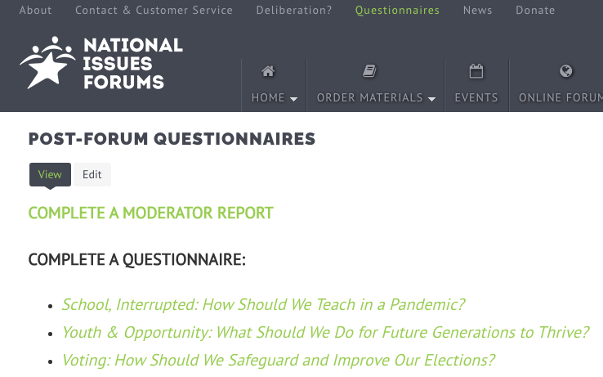
Post Forum Questionnaire
Now that you’ve had a chance to participate in a forum on this issue, we’d like to know what you’re thinking. Anonymous responses will be included in summary reports on the forums and in research to help us better understand how people are thinking about current issues.
You may fill out this questionnaire online. https://www.surveymonkey.com/r/schoolinterrupted .
THANK YOU!

