Slide 1
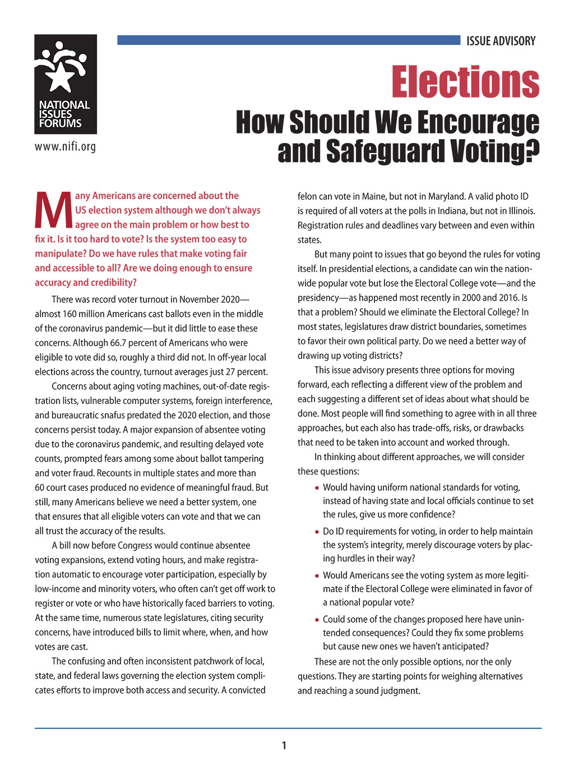
WELCOME
National Issues Forum
on
Elections
[insert date]

Slide 2
Holding a Deliberative Forum
1. Introduction
2. Connect to Issue
3. Consider Each Option
4. Review and Reflect
Review ground rules.
Introduce the issue.
Ask people to describe how the issue affects them, their families, or friends.
Consider each option one at a time.
Allow equal time for each.
What is attractive?
What about the drawbacks?
Review the conversation as a group.
What areas of common ground were apparent?
What tensions and trade-offs were most difficult?
Who else do we need to hear from?

Slide 3
Discussion Starter Video
Link to video: https://vimeo.com/561864289

Slide 4
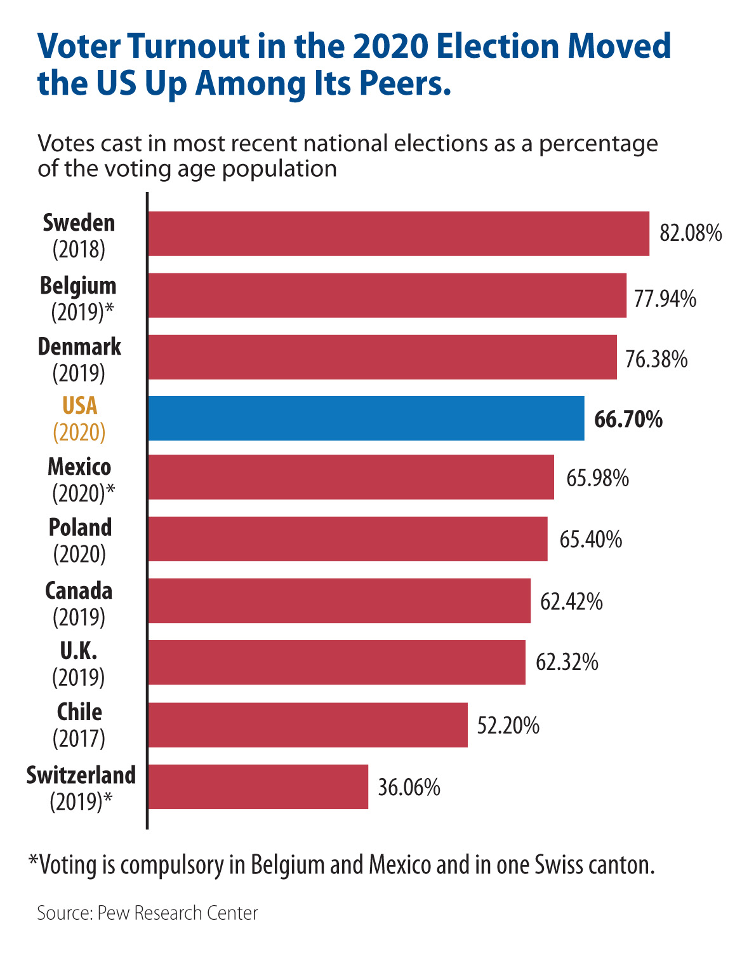

Slide 5
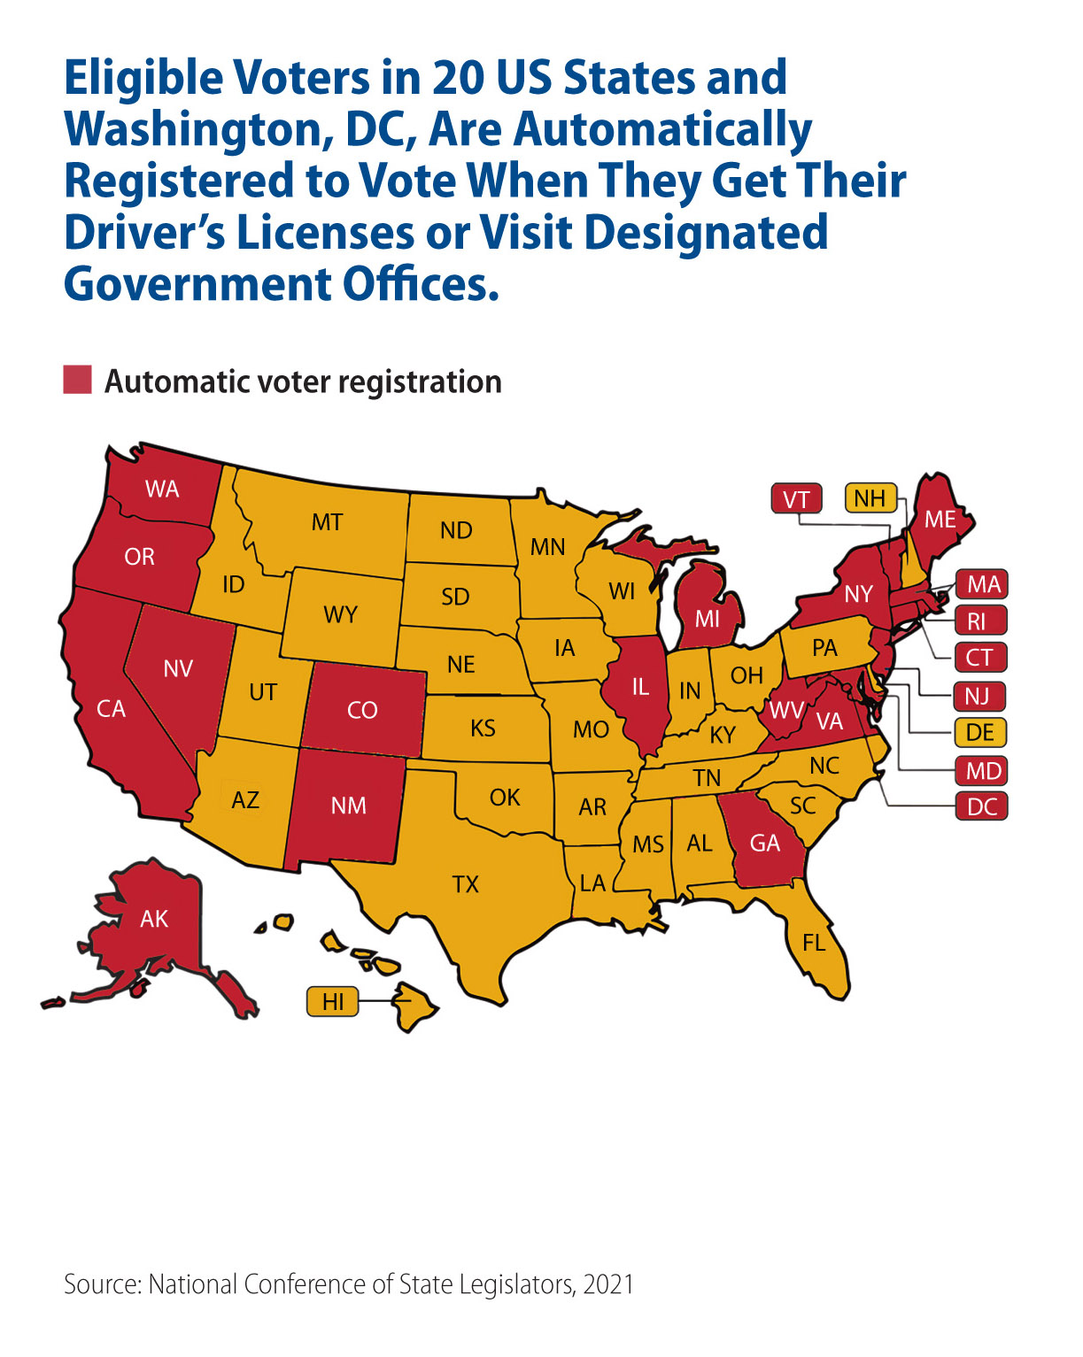

Slide 6
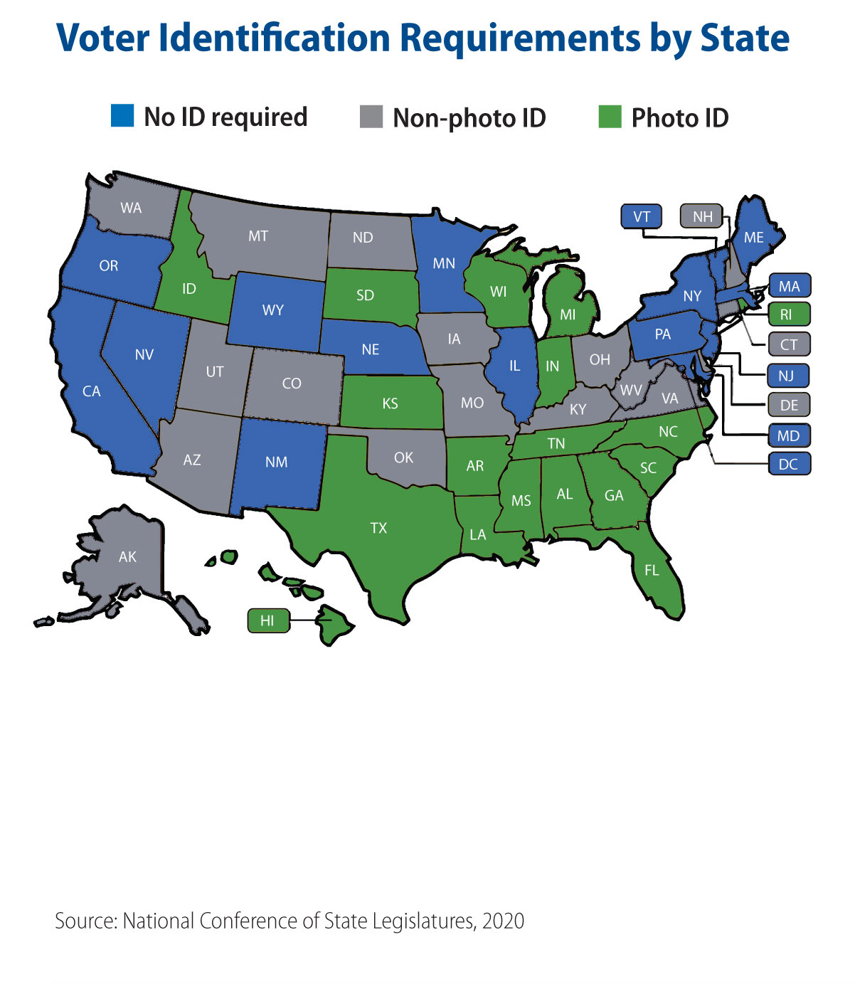

Slide 8
Guidelines for a Forum
Focus on the options and actions we can take nationally and in our communities.
Consider all options fairly.
Listening is just as important as speaking.
No one or two individuals should dominate.
Maintain an open and respectful atmosphere.
Everyone is encouraged to participate.

Slide 9
OPTION 1:
Make it easier to register and vote.
A nurse working a 12-hour shift on Election Day may not get off before the polls close.
Voters in neighborhoods with limited polling places endure hours-long lines, with communities of color often hit hardest.
Some states require a driver’s license or other government-issued photo ID to vote, but many elderly or low-income Americans don’t drive and lack access to needed records.
Voter registration rules and procedures differ from state to state, and in most, it is up to the individual to get registered.
A Primary Drawback
  Some changes that make voting easier may reduce the safeguards that ensure that only eligible voters cast ballots. And a lack of trust in the integrity of the voting system produces division and second-guessing, no matter who wins.
This option says
that giving every American a chance
to vote should be our priority.

Slide 10
Option 1: Make it easier to register and vote.
Actions
Possible Drawbacks
Offer in-person early voting for 15 days for at least 10 hours a day so people have more chances to vote and long lines and wait times can be eliminated.
Keeping polling places open and staffed will be a huge investment for local governments or would require new federal funding at a time of massive deficits.
Make Election Day a national holiday as other countries do.
This will hurt small businesses by forcing them to either close on Election Day or pay their workers more to stay open. And it wouldn’t help essential workers such as nurses and firefighters.
Automatically register all those eligible to vote whenever they get a driver’s license or visit designated government offices.
Automatically adding people to a public database is intrusive and violates their privacy. And there is no assurance it will improve voter turnout since it does not mean those who are registered will vote.
Allow people who have completed prison sentences to vote. They have paid their debt to society.
People convicted of serious crimes have forfeited their right to vote.
What else could we do, especially on a community level?
What’s the trade-off if we do that??

Slide 11
Make it easier to
register and vote.
1
Automatic registration makes the process easier, but couldn’t it also increase the chances of accidentally including ineligible people? What should we do to make sure voting roles are accurate?
OPTION 1
Questions for deliberation
2
Suggestions to make voting easier—extended poll hours, mail-in ballots, etc.—are often quite costly. With government budgets strained at all levels, what would you be willing to cut to pay for these changes?

Slide 12
OPTION 2:
Do more to make elections secure.
The Constitution allows each state to control its own election procedures, which adds to the challenge of securing elections, especially in an environment where foreign governments are actively trying to interfere.
There are few uniform standards. For example, five states conduct their voting almost entirely by mail, while others sharply restrict it.
In eight states, there is no paper record of ballots casts.
Methods for checking registration databases to clean the rolls of voters who have moved or died vary widely among states.
A Primary Drawback
  Steps intended to fight fraud often end up discouraging legitimate voters, especially low-income and minority voters.
This option says
that making elections more secure should be our priority.

Slide 13
Option 2: Do more to make elections secure.
Actions
Possible Drawbacks
Require photo ID for all federal, state, and local elections. This will be much more reliable than just matching signatures.
Making voter ID a requirement will deprive millions of the basic right to vote, especially older Americans and those who do not drive.
Require voters to apply for and give a valid reason, such as travel or illness, for absentee voting.
People should be able to vote absentee for any reason. This requirement would just make it harder for many people to vote.
Use only voting machines that scan voter-prepared paper ballots, and mandate that all election boards keep a paper trail.
Paper-based voting systems are slow and inefficient. Some election outcomes will not be known for days or weeks after the ballots have been cast.
Remove voters from registration rolls if they haven’t voted recently.
Americans have the right to sit out elections where the issues or the candidates don’t interest them. This just discourages people when they do want to vote.
What else? What could we do, especially as a community?
What’s the trade-off if we do that?

Slide 14
Do more to make
elections secure.
1
People show IDs to get on planes and rent cars, and there are alternative IDs for people who don’t drive. Wouldn’t this be a straightforward and minimally intrusive requirement for voting. Why or why not?
OPTION 2
Questions for deliberation
2
More federal involvement in safeguarding elections would bring expertise and resources to strapped local election boards. But could the federal government use its power to steer outcomes and/or discourage opposing party members from voting?

Slide 15
OPTION 3:
Offer more and better choices.
Many people believe that their views are not fully represented by either of the major party’s candidates, as shown by the rising number of voters registering as Independents.
Others believe that their vote doesn’t matter because they live in districts drawn to favor one party’s candidate. Races in these gerrymandered districts are rarely competitive.
In presidential elections, the Electoral College makes so-called swing states more important, so candidates tend to ignore voters elsewhere.
What’s more, the Electoral College system means that the votes of rural Americans count more than the votes of those in populous states, so it violates the principle of one person-one vote.
A Primary Drawback
  Having two traditional parties has served the United States well, and drastically redesigning the voting system could have unforeseen consequences.
This option says
that changing the system to offer all voters real choices should be our priority.

Slide 16
Option 3: Offer more and better choices.
Actions
Possible Drawbacks
Make sure congressional districts are not slanted in favor of either party by having nonpartisan commissions, rather than politicians, draw the districts fairly.
Rural and minority voters will lose power if districts are redrawn without their interests in mind, and even “nonpartisan” commissions can be manipulated.
Make it easier to run for office by publicly funding candidates and easing requirements so that voters have more and different candidates to choose from.
This means public money will be spent on people with almost no chance of winning, including unqualified fringe candidates who are merely seeking attention.
Encourage candidates to campaign in all states by eliminating the Electoral College and using the popular vote instead.
This requires changing the Constitution and gives less populous rural states less say in the outcome, which could result in their needs being ignored.
Increase participation in primaries by ending registration by party (as 19 states have done already) so that all voters can participate in either party primary.
Political parties have the right to choose their own candidates, and this could lead to some partisan voters switching primaries just to undercut the other party’s most promising candidates.
What else? What could we do, especially as a community?
What’s the trade-off if we do that??

Slide 17
Offer more and
better choices.
1
What could be the unanticipated consequences of ending the Electoral College and allowing commissions to draw Congressional districts? Are we willing to take these risks?
OPTION 3
Questions for deliberation
2
Changing voting laws is always difficult and controversial. Could trying to make these broader, longer-term changes pull attention away from more urgent problems like backing up voting systems and guarding against voter suppression?

Slide 18
CLOSING REFLECTIONS
On what do we agree?
About what do we need to talk more?
From whom else should we hear?
What else do we need to know?
How do the ideas and options in this guide affect what we do as individuals or as members of a community?
How might our actions affect the nation in the future?
Other questions
to consider

Slide 19
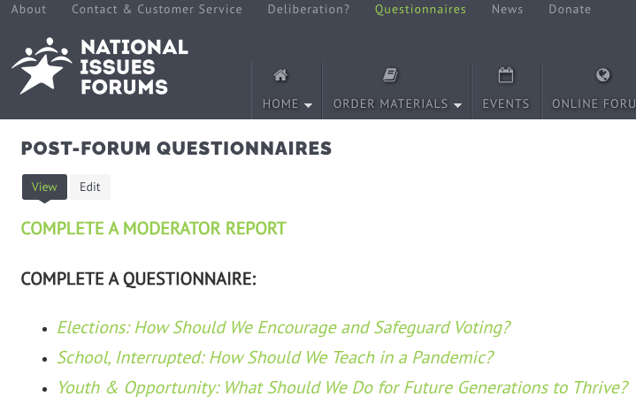
Post Forum Questionnaire
Now that you’ve had a chance to participate in a forum on this issue, we’d like to know what you’re thinking. Anonymous responses will be included in summary reports on the forums and in research to help us better understand how people are thinking about current issues.
You may fill out this questionnaire online. https://www.surveymonkey.com/r/elections-nifi
THANK YOU!

