Slide 1
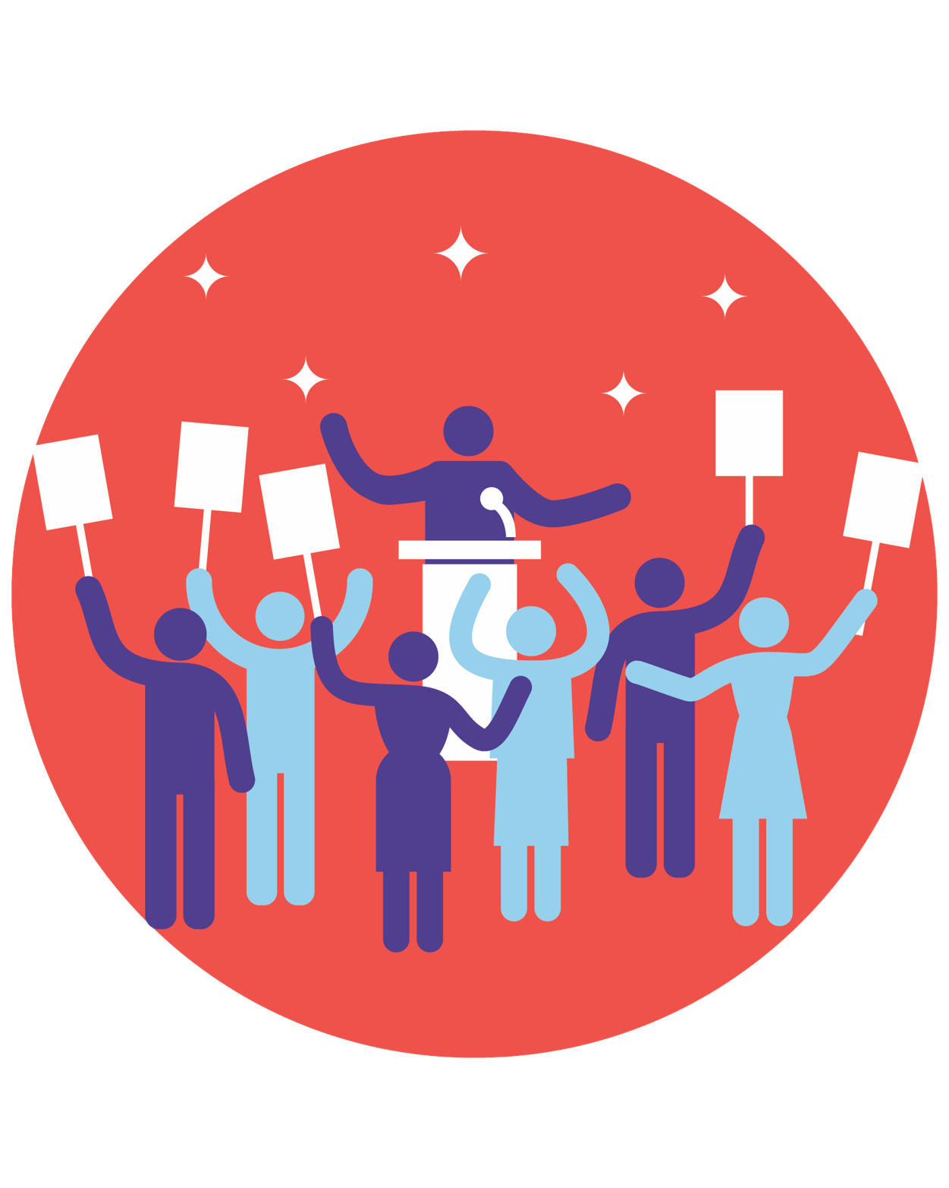
Elections:
How Should We
Encourage and Safeguard Voting?
Welcome to a National Issues Forum
Fall 2022

Slide 2
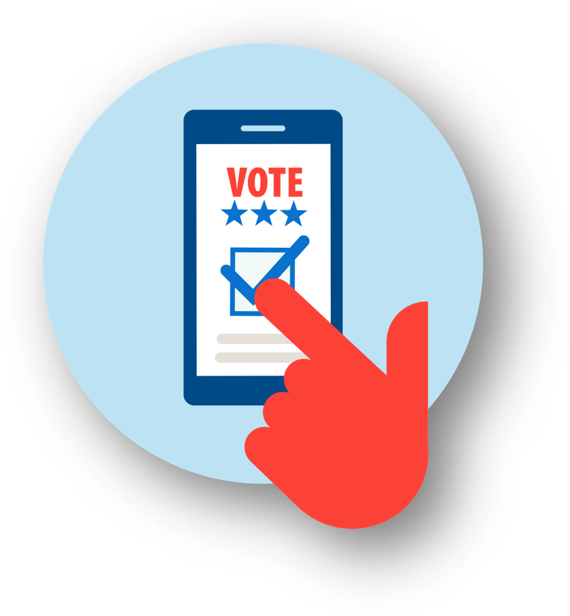
The Purpose of an NIF Forum
To weigh different approaches for addressing a problem and exchange views with others on what should be done
Welcome to a National Issues Forum
2024

Slide 3
Today’s Forum
1.
Introduction
We’ll agree to some guidelines.
We’ll focus on voting and the US election system—the kind of system we want to have. We’ll share our experiences and listen to others. We’ll look to the future and consider a range of practical changes.
2
Share our concerns
We’ll weigh three different approaches to fixing our voting system, along with some specific proposals for each. These aren’t the only ideas, but they are a starting point.
3
Consider each approach
We’ll look at:
Advantages, risks, costs, & trade-offs
Possible unintended consequences
Priorities—we can’t do everything
Areas of common ground & remaining concerns
4
Review and reflect

Slide 4
Forum Guidelines
Consider all the approaches fairly.
Listening is just as important as speaking.
No one or two individuals should dominate.
Maintain an open, respectful atmosphere.
Everyone is encouraged to participate.

Slide 5
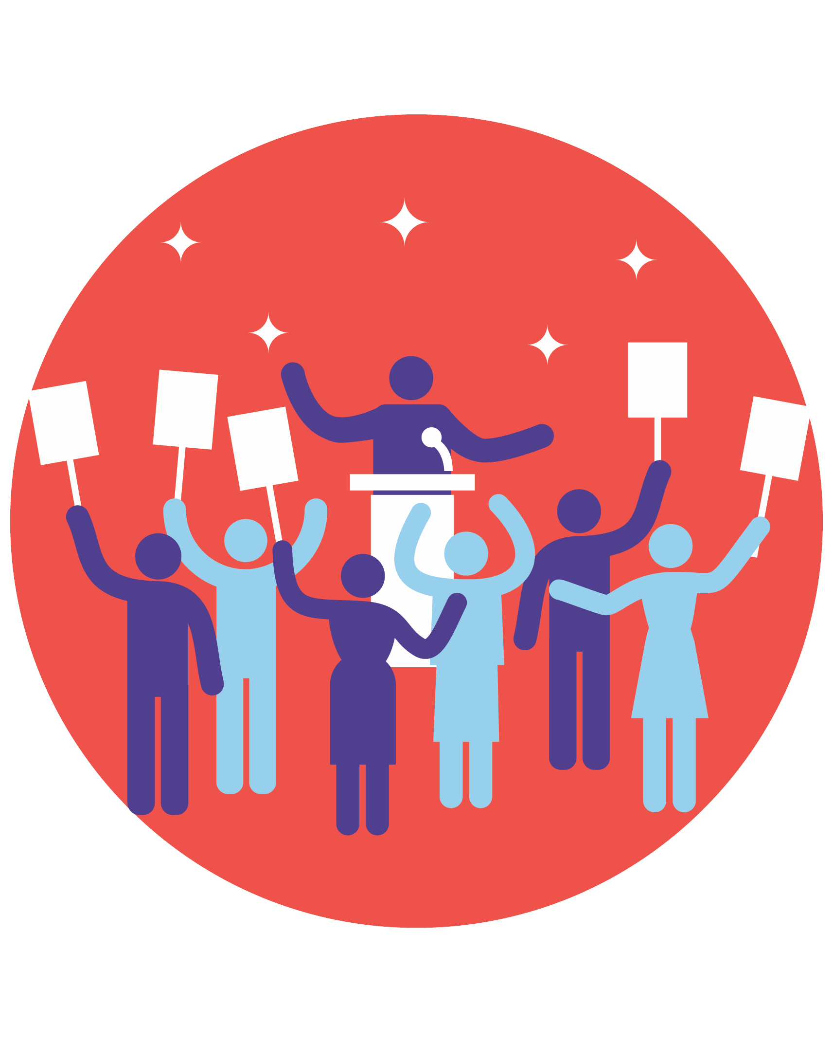
What is the PROBLEM?
Possible Concerns about the Current System
Sometimes it’s difficult and inconvenient for me to vote
There are too many efforts to suppress the vote in minority communities
Too many Americans don’t bother to vote and take democracy for granted
There seems to be too much voter fraud
Too often we end up with candidates who are too extreme
Something else?

Slide 6
APPROACH 1:
Make It Easier
to Vote
Let’s make sure all
Americans get a chance to vote by keeping polls open longer and mailing paper ballots to all registered voters.
APPROACH 2:
Protect Against Cheating
Let’s prevent cheating by requiring photo IDs, limiting mail-in paper ballots, and cleaning up voting rolls to remove those who may have died or moved away.
APPROACH 3:
Change the System
Let’s create a system that gives us better elections and candidates by opening primaries to Independents, ending the Electoral College, and having nonpartisan commissions draw Congressional districts.
But could these changes make it easier for people to cheat?
But could these changes make it more difficult to vote?
But could redesigning the election system have unintended consequences?
And . . . it’s unlikely everyone will agree. Few of us are likely to get all the changes we want.
So, what is your
top priority?

Slide 7
Just to Start
We’ll talk more about each of these approaches,
but just to start, which is most important to you now?
Approach 1: Make It Easier to Vote
Approach 2: Protect Against Cheating
Approach 3: Change the System

Slide 8
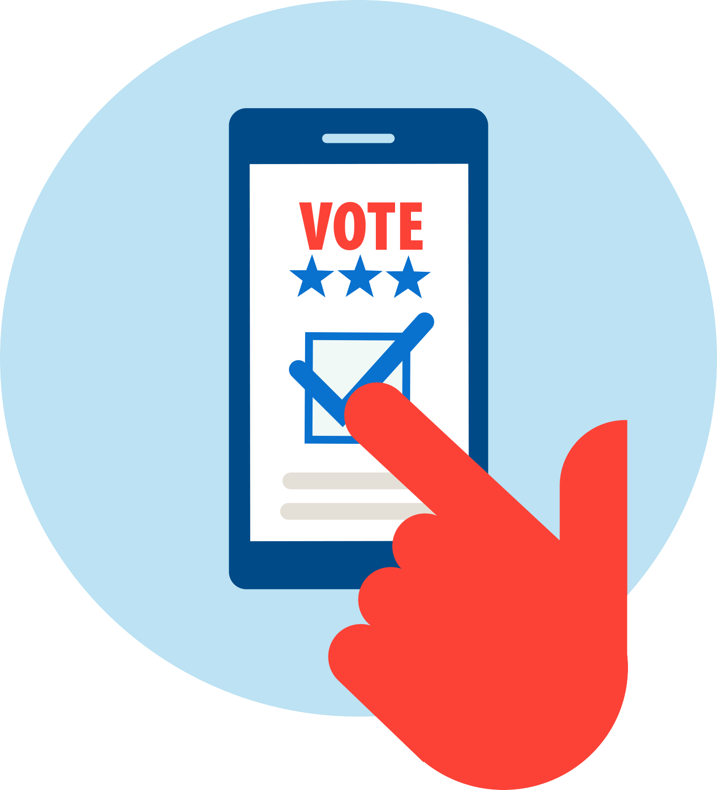
Make it easier to vote
APPROACH 1
Voting is one of the most important ways we improve our country, and it should
be simple and convenient. But if you work long hours or live far from a polling place
or face long lines or miss the registration date, you don’t have a fair chance. Given our
country’s low turnouts and history of voter suppression, our priority should be to make voting accessible to all.
PROPOSALS | POSSIBLE DRAWBACKS
Offer in-person early voting for extended hours and for two weeks before Election Day. | This is a huge cost for local governments, and people often wait until the last minute anyway.
Make Election Day a national holiday, as some other countries do. | This will hurt small businesses and won’t help essential workers such as nurses and firefighters.
Send mail-in ballots to all registered voters. Some states already do this regularly. | This means blanketing the state with paper ballots and makes it easier for people to steal or misuse them.
POSSIBLE DRAWBACKS
But how easy should it be? Is it truly unfair to ask people to make the time to go to vote?

Slide 9
Protect against cheating
APPROACH 2
Voting should represent the will of the people, and we should make changes to guarantee
the accuracy and security of our elections. We have too many out-of-date registration lists
and poorly monitored voting practices. The system is just too lax. Our priority should be to ensure that
all votes are cast legitimately and counted correctly. Making it harder to cheat will give everyone confidence.
PROPOSALS | POSSIBLE DRAWBACKS
Require photo ID for voting, like we do to get on a plane. It’s more reliable than matching signatures. | This makes voting difficult for people who don’t drive or have another photo ID.
Only allow mail-in ballots for people who present a valid excuse, such as travel or illness. | Mail-in voting is much easier for those who work long hours or care for others. Limiting this option could reduce voter participation.
Remove people from voter rolls if they haven’t voted in the past five years. This helps eliminate the names of people who have died or moved. | Americans have the right to sit out elections. This causes problems for people when they do want to vote.
POSSIBLE DRAWBACKS
But we have a history of voter suppression and still see instances of people waiting hours in lines to vote. Shouldn’t states be required to make voting easier for everyone?

Slide 10
Change the system
APPROACH 3
The problem is more fundamental—the current system seems engineered to limit voters’
choices. Politicians can draw Congressional districts to favor their own party. In some states,
primaries aren’t open to Independent voters. And presidential candidates can win the popular vote
but lose the election because of the Electoral College. These changes should be the priority.
PROPOSALS | POSSIBLE DRAWBACKS
Have nonpartisan commissions draw Congressional districts so neither party is favored. | Even “nonpartisan” commissions can be manipulated.
Eliminate the Electoral College and rely on the popular vote instead. | This requires changing the Constitution and gives voters in rural areas less say in the outcome. Candidates may ignore their concerns.
Let registered Independents participate in primaries for either party. This will give us more moderate candidates. | This damages the two-party system and will lead to a lot of candidates who try to please everyone.
POSSIBLE DRAWBACKS
But the US has benefited from a strong two-party system, and countries with many political parties are often unstable and ungovernable. Is it so smart to move away from our current approach?

Slide 11
Here’s what we talked about…
In-person early voting
A national holiday
Send mail-in ballots to all voters
Require photo ID
Mail-in ballots only with a valid excuse
Remove names of those who haven’t voted for five years
Nonpartisan commissions draw Congressional districts
Eliminate the Electoral College
Allow registered Independents to vote in primaries
Which 1 or 2 proposals do you most FAVOR?
Which 1 or 2 proposals do you most OPPOSE?

Slide 12
Here’s what we most favor and oppose…
MOST FAVORED IN GREEN / MOST OPPOSED IN RED
In-person early voting
A national holiday
Send mail-in ballots to all voters
Require photo ID
Mail-in ballots only with a valid excuse
Remove names of those who haven’t voted for five years
Nonpartisan commissions draw Congressional districts
Eliminate the Electoral College
Allow registered Independents to vote in primaries

Slide 13
Going Back to the 3 Basic Approaches
Now that we’ve talked, if YOUR STATE could focus
on only one approach, which should it be?
Approach 1: Make It Easier to Vote
Approach 2: Protect Against Cheating
Approach 3: Change the System

Slide 14
The Group’s Overall Results
Did we make any progress?
Could you live with the changes
the group agreed on if they were enacted?

Slide 15
Closing Reflections
Are there important ideas we didn’t talk about?
Are there areas where we’re divided and need to talk more?
Who else should we hear from?
What actions could we take as individuals?
What should we expect from candidates we support?
OTHER QUESTIONS TO CONSIDER:

Slide 16
How Did We Do?
Did we talk about aspects of this issue you hadn’t considered before?
Did you have any second thoughts?
Was the information fair and unbiased?
Did you feel comfortable discussing these issues with the group?

Slide 17
After the session, please feel free to keep or remove the Zoom application from your phone. If you need help with deleting it, please let us know.
Thank you for participating!
For more information about National Issues Forums,
please visit www.nifi.org

