Slide 1
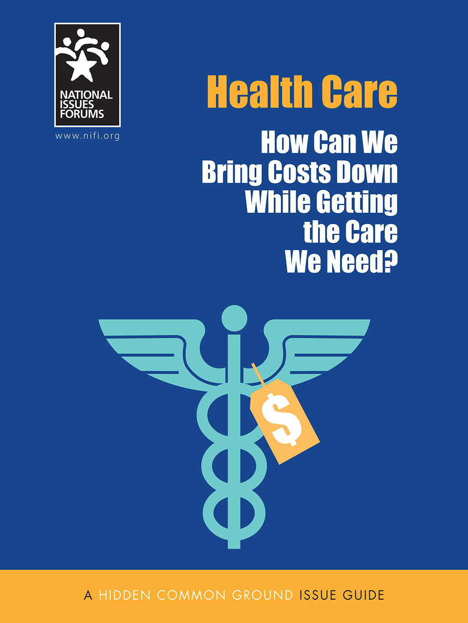
WELCOME
NATIONAL ISSUES FORUM
ON
HEALTH CARE
[INSERT DATE]

Slide 2
Holding a Deliberative Forum
1. Introduction
2. Connect to Issue
3. Consider Each Option
4. Review and Reflect
Review ground rules.
Introduce the issue.
Ask people to describe how the issue affects them, their families, or friends.
Consider each option one at a time.
Allow equal time for each.
What is attractive?
What about the drawbacks?
Review the conversation as a group.
What areas of common ground were apparent?
What tensions and trade-offs were most difficult?
Whom else do we need to hear from?

Slide 3
Ground Rules for a Forum
Focus on the options and actions we can take nationally and in our communities.
Consider all options fairly.
Listening is just as important as speaking.
No one or two individuals should dominate.
Maintain an open and respectful atmosphere.
Everyone is encouraged to participate.

Slide 4
STARTER VIDEO https://www.nifi.org/en/issue-guide/health-care-2020

Slide 6
Option 1: Ensure Health Care for All
This option says that all Americans deserve health-care coverage and the fairest way to provide it is to create a single public health insurance program similar to Medicare that covers everybody.
Our current confusing mix of private and public payers leaves even many people who have insurance struggling to afford co-pays, deductibles, premiums, and out-of-pocket expenses as well as worried that they will lose their coverage altogether.
Every developed country except the United States provides its citizens with some type of universal coverage that includes both health services and protection from unaffordable costs.
Health care should not depend on a person’s income, job, or medical history.
A Primary Drawback
This drastic overhaul would eliminate private, job-based insurance that now covers 181 million Americans and create a huge new government responsibility and bureaucracy.

Slide 8
Option 1: Ensure Health Care for All
Possible Actions
Drawbacks
Immediately bring the 28 million people who do not have health insurance into a new public plan similar to Medicare. No American should have to go without insurance.
The United States is already deeply in debt and can’t afford a new government benefit. Expanding Medicare could divert care from the seniors and people with disabilities it was created to serve.
Move people with private and job-based insurance onto the public plan. Having a single payer will simplify our complicated system and save on paperwork and administrative costs.
Forcing people onto a Medicare-like plan whether they want it or not would upend our entire healthcare system. Individuals and employers may save on premiums but may well have to pay new taxes.
Use government’s enormous purchasing power to force hospitals, doctors, and drug companies to drop and hold down prices.
Since the government pays less, this could discourage people from going into the medical field and lead to doctor and nurse shortages.
Outlaw astronomical jury awards for malpractice. The fear of lawsuits drives doctors to order unnecessary tests and pass on the high costs of malpractice insurance.
We will lose an important way of making sure doctors and hospitals are more careful. Medical errors kill up to 250,000 Americans a year.
What else?
The trade-off?

Slide 9
Option 2: Build on What We Have
This option says we should fix what’s broken about health care—not destroy the whole system currently in place.
Improving the mix of private and public options we already have is the safest and least disruptive way to bring down costs and still get the good health care we deserve.
To cover more people and protect patients from high prices, we should strengthen and build on the 2010 Affordable Care Act.
Its reforms already require insurers to cover preexisting conditions, make many preventive services free, and cut the percentage of people who do not have health insurance from 14 percent down to 9 percent.
A Primary Drawback
Keeping the private insurance system we have now means continuing to waste billions of health-care dollars on profits, advertising, duplicative paperwork, and red tape.

Slide 11
Option 2: Build on What We Have
Possible Actions
Drawbacks
Expand Medicaid in every state to cover not just the very poor but also working people without insurance.
This maintains a system in which the wealthy get excellent insurance while others must use Medicaid, which many doctors won’t even take.
Require everyone to have health insurance so it will be more affordable overall. When everybody pays in, healthy people help pay for those needing more care.
This requires people to buy insurance whether or not they want it or can afford it. Why should people who are young or who take good care of their own health subsidize others?
Emphasize prevention, which would encourage personal responsibility and lower costs by reducing the need for more expensive specialist care and prescriptions.
This doesn’t control costs. Insurance companies could still charge people and employers whatever they want for coverage and hospitals could charge whatever they want for care.
Require everyone to have a living will—written instructions to guide medical decisions. This could avoid expensive end-of-life care and encourage hospice use instead.
Making people sign living wills could make them feel like a burden to their loved ones and pressure them to give up care that might extend their lives.
What else?
The trade-off?

Slide 12
Option 3: Let People Make Their Own Choices
This option says we should keep government out of health care and give Americans the power and responsibility for making their own decisions.
This is the best way to get costs down without giving up our freedom.
People should be able to choose the health insurance plan they think is best and most affordable for them or go without insurance if they don’t want it.
To make good choices about treatment, they need clear information up front about what things cost and better incentives to budget and save in advance.
People who can’t afford care can fall back on a safety net of public hospitals or emergency rooms.
A Primary Drawback
Many people without insurance will develop health problems or die because they don’t get regular care. Neglect leads to higher costs in emergency rooms and public hospitals, which we all end up paying.

Slide 14
Option 3: Let People Make Their Own Choices
Possible Actions
Drawbacks
Make insurance more affordable by allowing people to buy stripped-down plans that offer fewer benefits. No one should have to pay for coverage they don’t think they will need.
Stripped-down plans may not catch health problems early enough or cover unexpected illnesses and injuries. People could end up with more complicated, expensive conditions that their plans won’t cover.
Allow employers to give workers tax-free money to buy health plans on their own in place of a company plan. This will lower business costs while promoting choice and responsibility.
People have little experience or leverage in negotiating complex benefits and prices. Few of us have the know-how to understand and compare competing plans.
Require hospitals, doctors, and drug companies to clearly show their prices. Giving people information to make their own decisions will spark competition and drive prices down.
People who are sick don’t have the time or ability to comparison shop. This could also drive prices higher once some providers realize they are charging less than their competitors.
Increase the tax breaks for people to put money into health savings accounts. This will encourage them to plan and save for future health-care costs.
This will give another tax benefit to the wealthy. Many people struggle just to save for retirement, let alone for unexpected and potentially huge health-care bills.
What else?
The trade-off?

Slide 15
Reflections on Your Forum
Now that we have deliberated, are there ideas or viewpoints you hadn’t considered before?
Can you now identify any shared concerns or hopes we have discovered in our conversation?
How has what you heard affected your thinking?
What could you do as an individual? What could the community do? What do we want our elected officials in Washington to do?
Can you identify any tensions that came up during the forum?
What questions remain? What work do we still need to do?

Slide 16
Post Forum Questionnaire
Now that you’ve had a chance to participate in a forum on this issue, we’d like to know what you’re thinking. Anonymous responses will be included in summary reports on the forums and in research to help us better understand how people are thinking about current issues.
You may fill out this questionnaire online. https://www.surveymonkey.com/r/healthcareadvisory2019.
THANK YOU!

