Slide 1
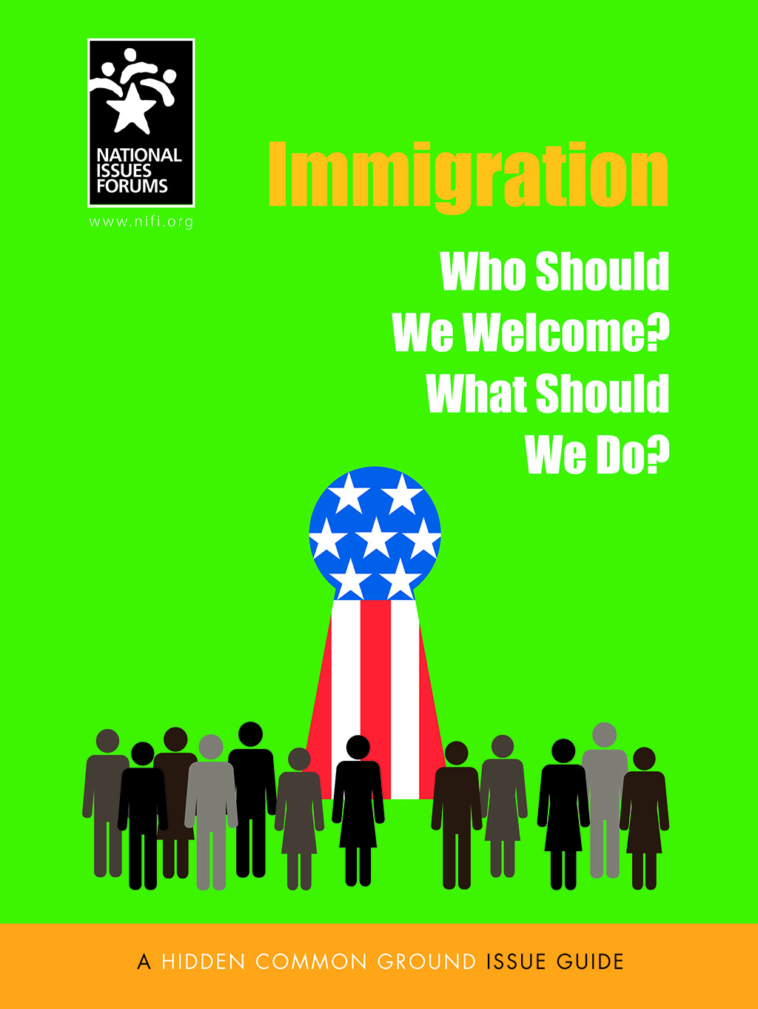
WELCOME
NATIONAL ISSUES FORUM
ON
IMMIGRATION
[INSERT DATE]

Slide 2
Holding a Deliberative Forum
1. Introduction
2. Connect to Issue
3. Consider Each Option
4. Review and Reflect
Review ground rules.
Introduce the issue.
Ask people to describe how the issue affects them, their families, or friends.
Consider each option one at a time.
Allow equal time for each.
What is attractive?
What about the drawbacks?
Review the conversation as a group.
What areas of common ground were apparent?
What tensions and trade-offs were most difficult?
Who else do we need to hear from?

Slide 3
Ground Rules for a Forum
Focus on the options and actions we can take nationally and in our communities.
Consider all options fairly.
Listening is just as important as speaking.
No one or two individuals should dominate.
Maintain an open and respectful atmosphere.
Everyone is encouraged to participate.

Slide 4
STARTER VIDEO Insert link

Slide 5
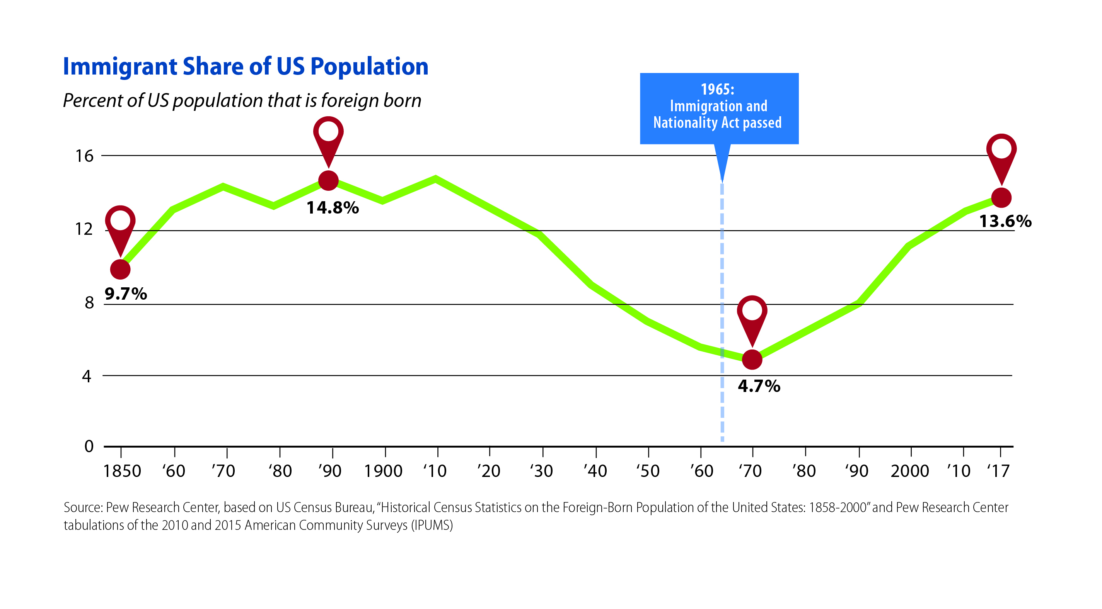

Slide 6
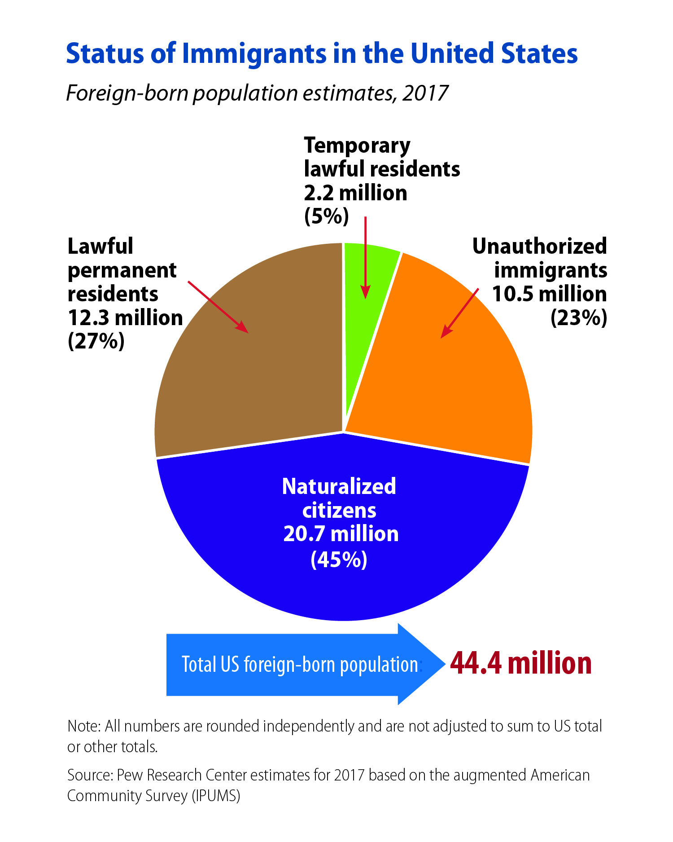
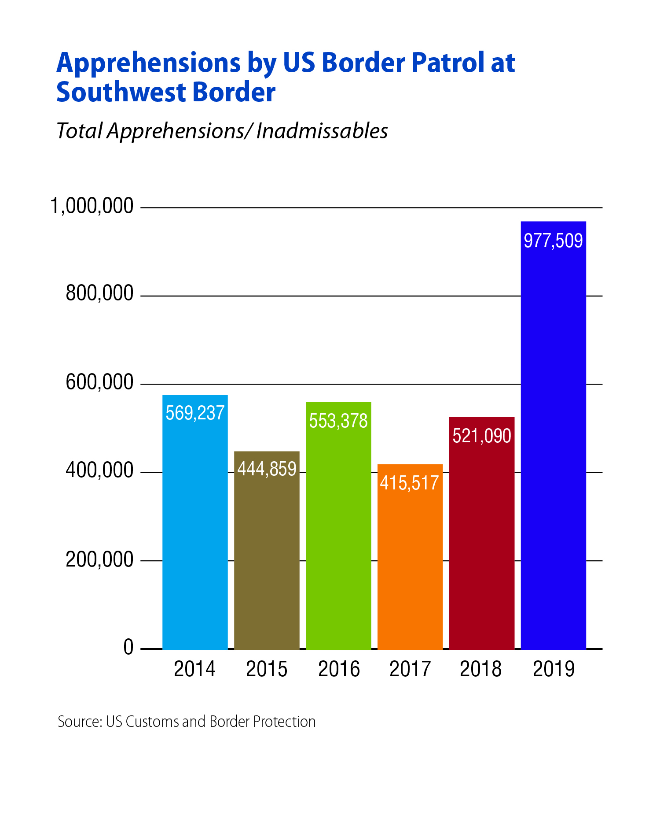

Slide 7
Option 1: Welcome Immigrants; Be a Beacon of Freedom
This option says that immigration has helped make the United States what it is today--a dynamic and diverse culture, an engine of the global economy, and a beacon of freedom around the world.
We should develop an immigration policy that builds on that tradition, one that welcomes newcomers, helps immigrant families stay together, and protects those fleeing war and oppression.
Welcoming immigrants is not only the right thing to do; it benefits our economy and counters falling US birth rates.
To remain competitive in a fast-changing global marketplace, the United States needs newcomers who are willing to contribute their skills to strengthening our culture of ingenuity and entrepreneurship.
A Primary Drawback
This option would add even more burden to systems already overwhelmed by historically high levels of immigration.

Slide 8
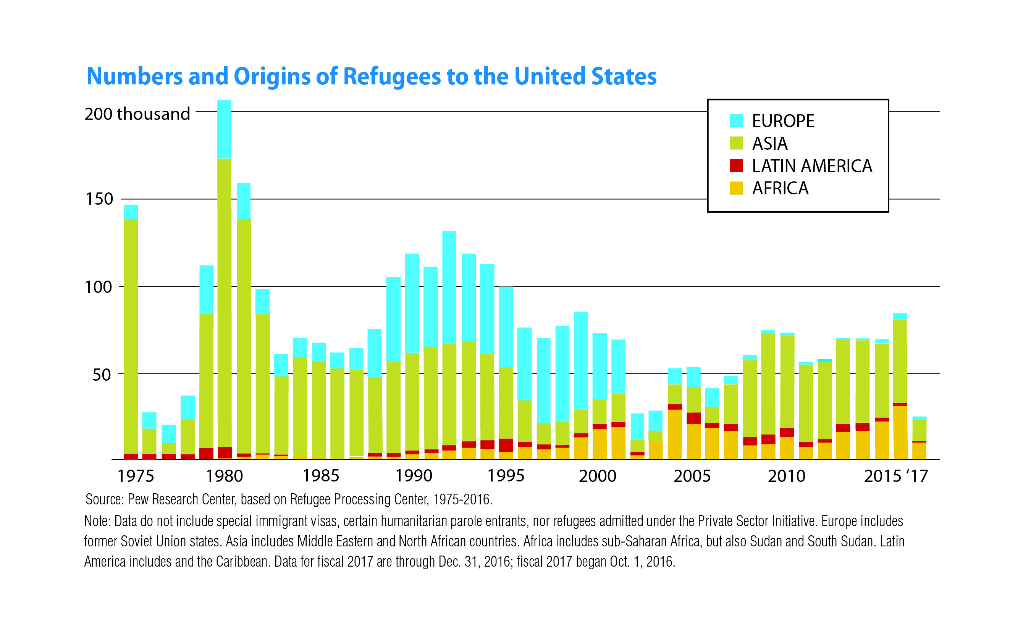

Slide 9
Option 1: Welcome Immigrants; Be a Beacon of Freedom
Actions
Drawbacks
Give those who entered the US without permission years ago a path to legal status. It’s time to forgive and welcome these people who have become part of our communities.
This allows immigrants who violated our laws to cut in front of the line of thousands of people who are seeking to enter the United States legally.
Welcome immigrants who are willing to work, whether in low-skilled jobs many Americans do not want or in high-skilled jobs where there are shortages.
Given how the pandemic shutdown has devastated our economy, we should focus on helping our own citizens learn new skills to get better jobs.
Accept more refugees fleeing violence and deprivation in countries such as Syria, El Salvador, and Guatemala. We have a moral obligation to help.
There are US citizens in need, too, and it is difficult to vet people coming from such areas of upheaval.
Provide legal residency and the ability to apply for citizenship to DREAMers, the term commonly used for undocumented immigrants who were brought to the United States as young children.
It’s not fair to allow this group to benefit form the illegal actions of their families.
Allow all residents to get driver’s licenses regardless of whether they are citizens or not.
This could make it easier from criminals and terrorists to get fake documents.
What else?
What’s the trade-off?

Slide 10
Option 2: Enforce the Law; Be Fair to Those Who Follow the Rules
This option says we need a fair system, in which the rules are clear and, above all, enforced.
Ever since the nation’s first immigration policies were put into place, the premise has been that welcoming newcomers should be done in an orderly way.
With an estimated 10.5 million people living in the country illegally, our current system is unjust and uncontrolled.
In fairness to the many people who are waiting to come to the US and stay here legally, we have an obligation to enforce our borders and deport people who enter the country without our permission.
We must strengthen our commitment to border security, crack down on those who overstay their visas, and introduce more stringent measures to deal with immigrants living outside the law.
A Primary Drawback
This will harm millions of people now living in our communities and contributing to our society. It will spread fear in cities and towns nationwide.

Slide 11
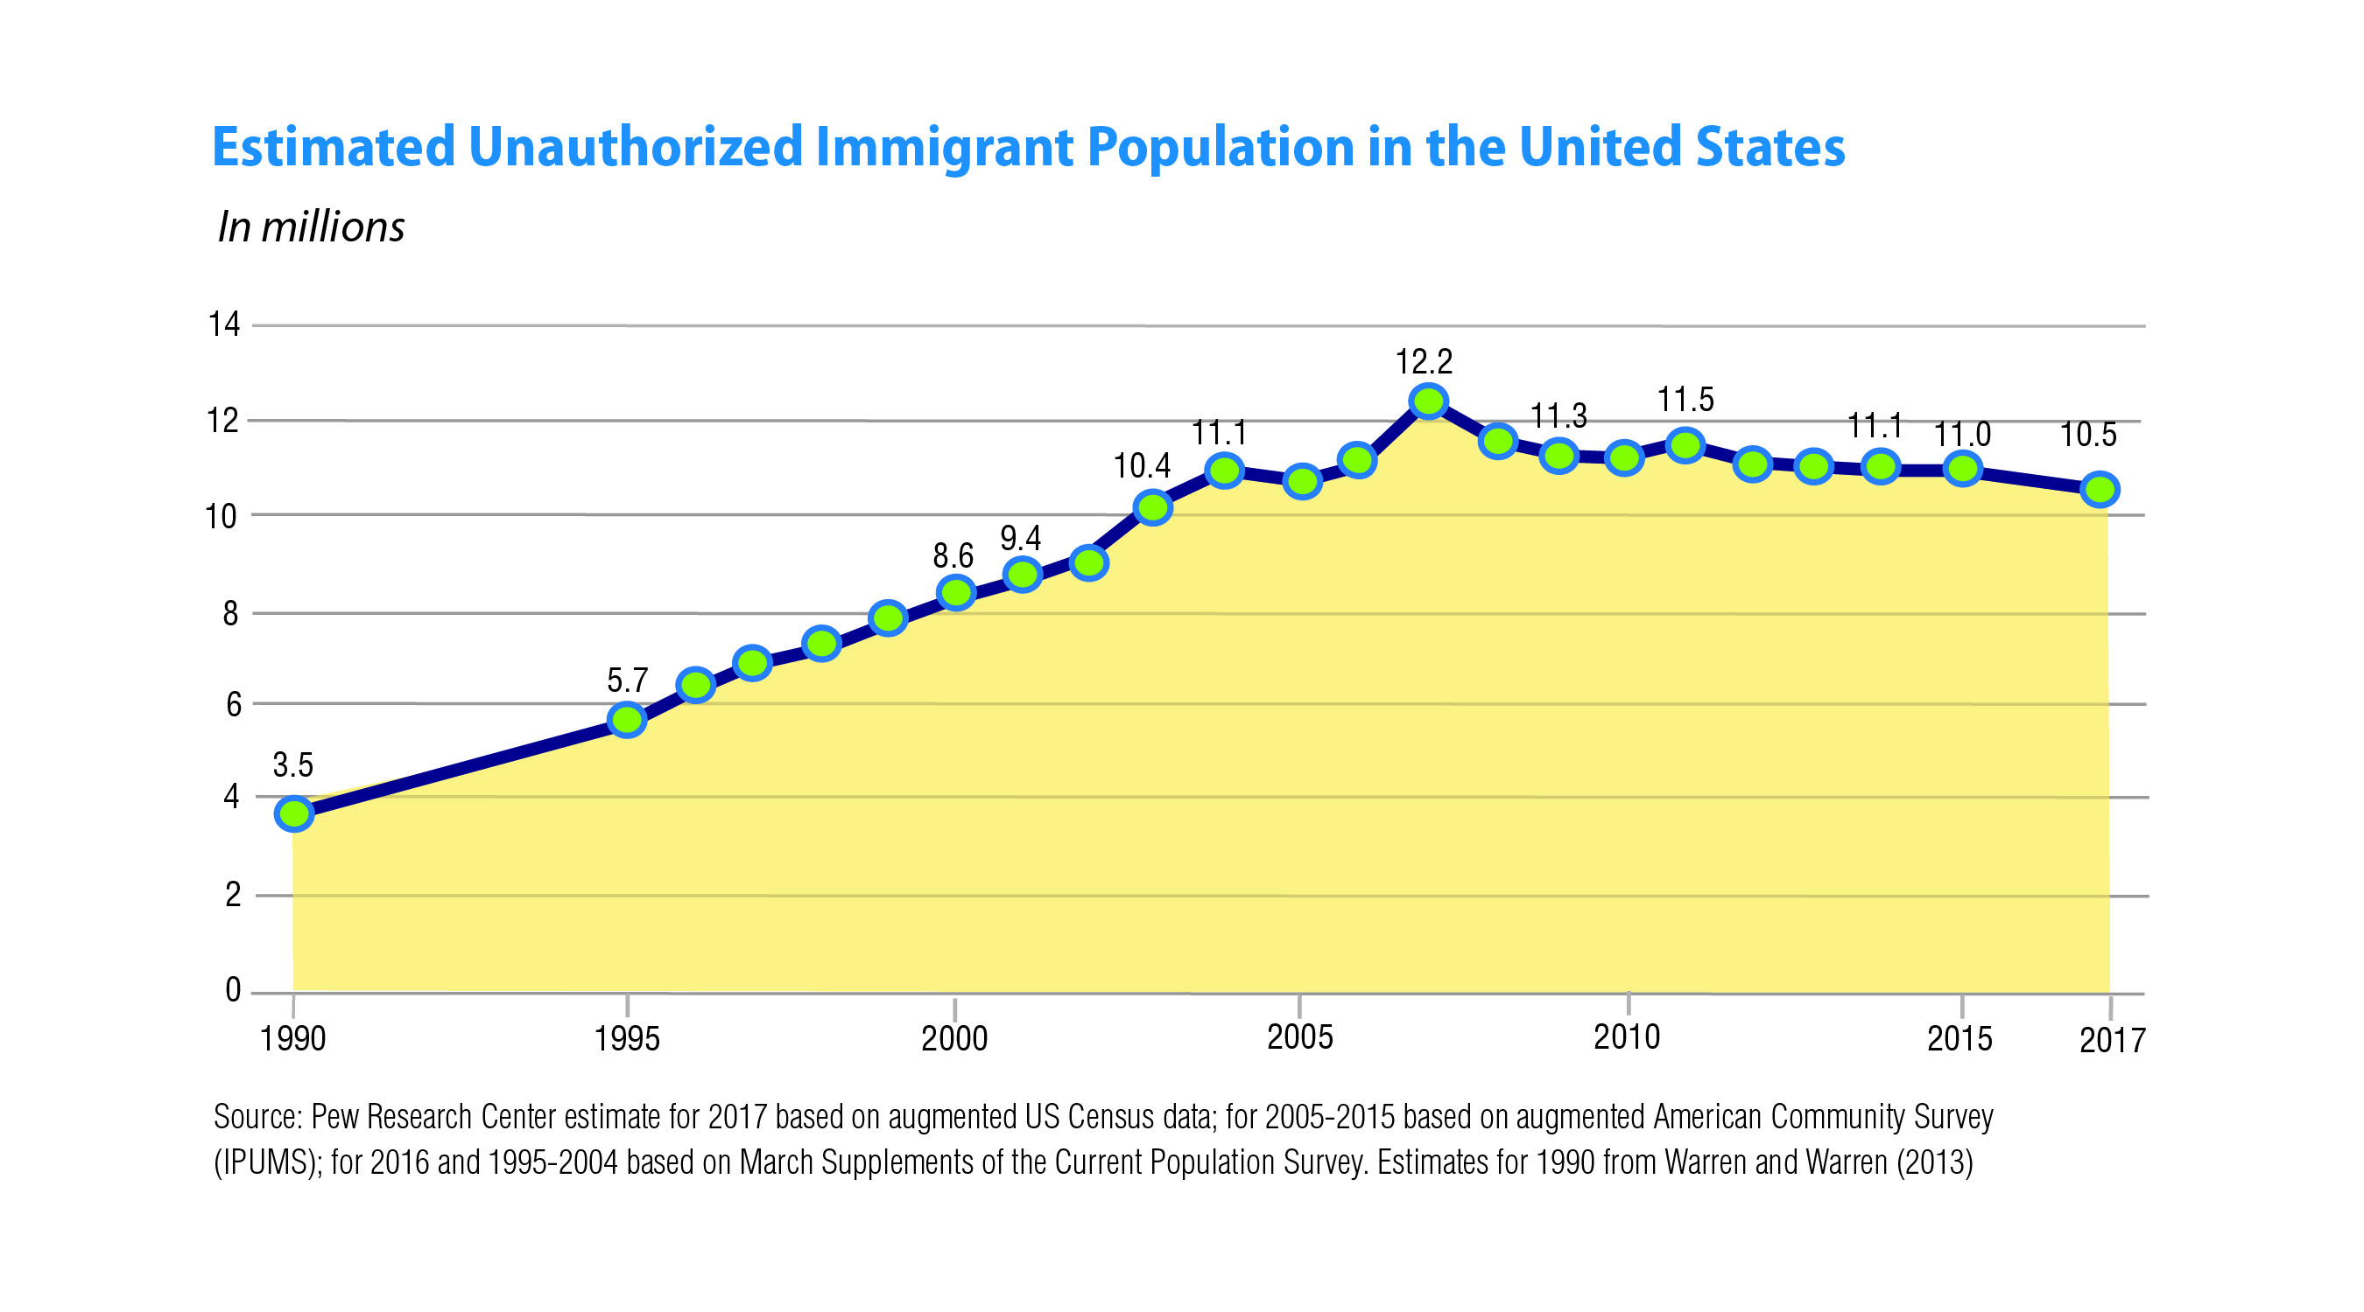

Slide 12
Option 2: Enforce the Law; Be Fair to Those Who Follow the Rules
Actions
Drawbacks
Identify people who entered the country illegally and deport them. Require that they reapply for entry.
This will tear up families—many of which include one or more US-born children. The punishment is not only impractical but far outweighs the crime.
Cut off federal funding, including pandemic economic recovery aid, to sanctuary cities that refuse to cooperate with federal immigration agents.
This punishes entire communities over disputes that should be settled in court. It could mean underfunded police departments and schools in some places and deny aid at a time of dire need.
Prosecute employers if they hire workers without legal papers.
This will create chaos in industries such as agriculture and construction and lead to higher prices for basic goods such as food and housing when times are already tough.
Build a secure southern boarder wall.
This will cost billions of tax dollars needed instead for pandemic recovery. Plus, it fails to address problems with people entering from Canada or through airports or people over-staying temporary visas.
Detain all adults who enter the country illegally even if this means separating families.
Such a zero tolerance policy traumatizes children who had no say in their parents’ decisions and invites international condemnation.
What else?
What’s the trade-off?

Slide 13
Option 3: Slow Down and Rebuild Our Common Bonds
This option recognizes that newcomers have strengthened our culture in the past.
The number of foreign-born residents has reached 44.4 million, or 13.6 percent of the population.
Fifty years ago, the foreign-born share of our population was 4.7 percent.
The country is now so diverse that we must regain our sense of national purpose and identity.
We need to moderate the flow of immigrants and focus more on helping newcomers integrate into US society.
We should have a measured immigration policy—one that reduces the rate of immigration and ensures that immigrants become part of the US community.
We need to find ways to accommodate newcomers without compromising our sense of national unity.
A Primary Drawback
This option would rob us of much of the energy and hard work people from around the world bring to the United States. The coronavirus pandemic only underscored how many of our “essential workers—serving in hospitals, staffing grocery stores, and producing food—are immigrants.

Slide 14
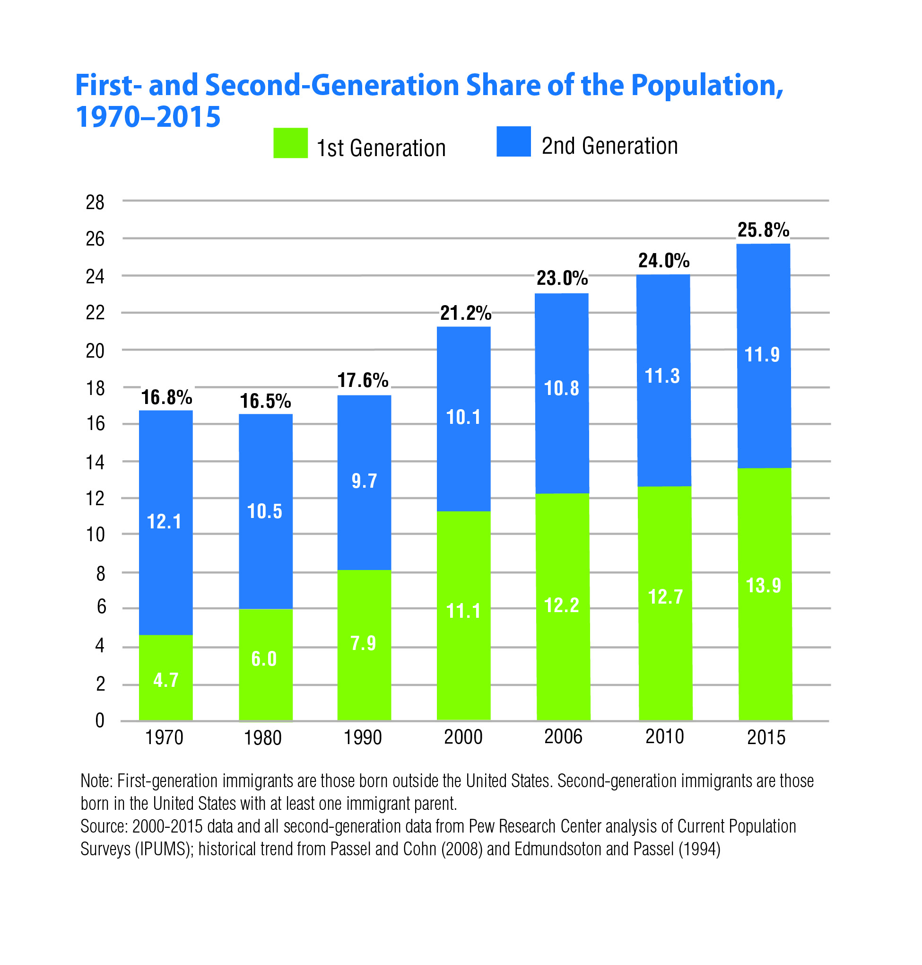

Slide 15
Option 3: Slow Down and Rebuild Our Common Bonds
Actions
Drawbacks
Reduce the number of legal immigrants admitted to the United States each year.
This deprives us of the workers needed in key industries such as agriculture and construction and could threaten the economy by lowering birthrates.
Given preference to immigrants who already speak English.
This would place an undue burden on some immigrants—especially those who are willing to take on some of the back-breaking jobs most Americans do not want.
Restrict family reunification to spouses and young children, and concentrate on admitting immigrants who will work in areas where we need them.
This would split immigrant families apart, forcing people who come here to leave loved ones behind, sometimes in danger or poverty.
Schools should require English immersion programs so newcomers learn the language as quickly as possible and absorb US culture and democratic values.
Special language programs take needed time and funds away from other important subjects. Besides, teaching classes in both languages would better prepare students to participate in today’s global economy.
Distribute refugees among many communities so they are not all resettled in the same few places, which overburdens the communities’ ability to absorb them and provide the support they need.
This would require more communities to accept and welcome newcomers.
What else?
What’s the trade-off?

Slide 16
Closing Reflections
Some important questions to consider are these:
On what do we agree?
About what do we need to talk more?
Who else should we hear from?
What more do we need to know?
How do the ideas and options in this guide affect what we do as individuals, as members of our communities, and as citizens and residents in the United States as a whole?

Slide 17
Post Forum Questionnaire
Now that you’ve had a chance to participate in a forum on this issue, we’d like to know what you’re thinking. Anonymous responses will be included in summary reports on the forums and in research to help us better understand how people are thinking about current issues.
You may fill out this questionnaire online. www.nifi.org/questionnaires.
THANK YOU!

