Slide 1
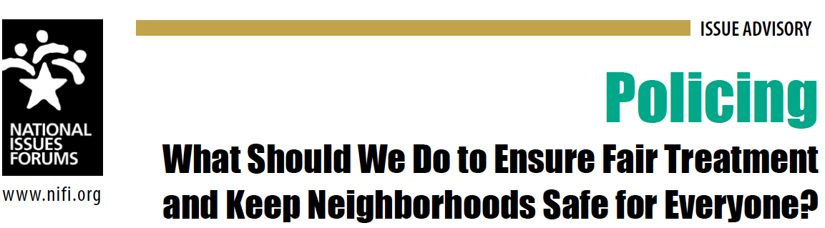

Welcome
National Issues Forums
on
Policing
[Insert Date]

Slide 2
Moderating a Deliberative Forum
1. Introduction
2. Connect to Issue
3. Consider Each Option
4. Review and Reflect
Review ground rules.
Introduce the issue.
Ask people to describe how the issue affects them, their families, or friends.
Consider each option one at a time.
Allow equal time for each.
What is attractive?
What about the drawbacks?
Review the conversation as a group.
What areas of common ground were apparent?
What tensions and trade-offs were most difficult?
Who else do we need to hear from?

Slide 3

Discussion Starter Video
Link to video: https://vimeo.com/manage/videos/665404969

Slide 4
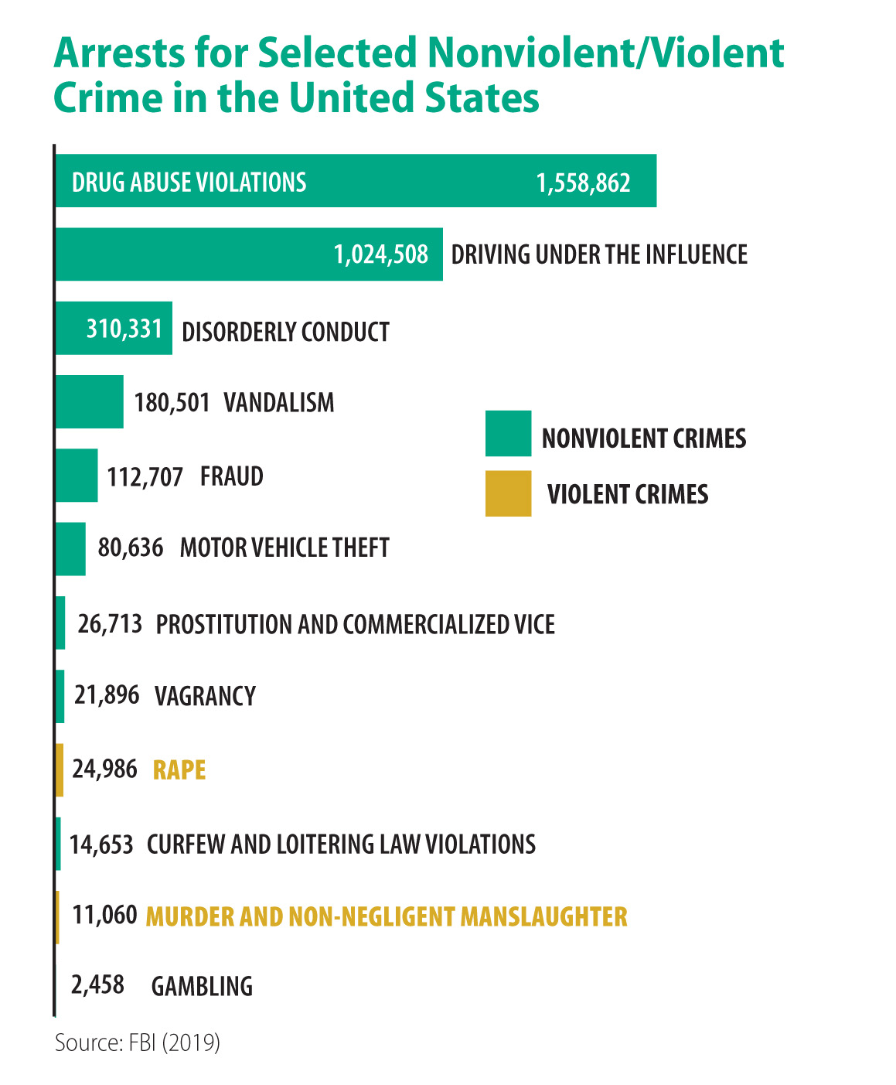

Slide 5
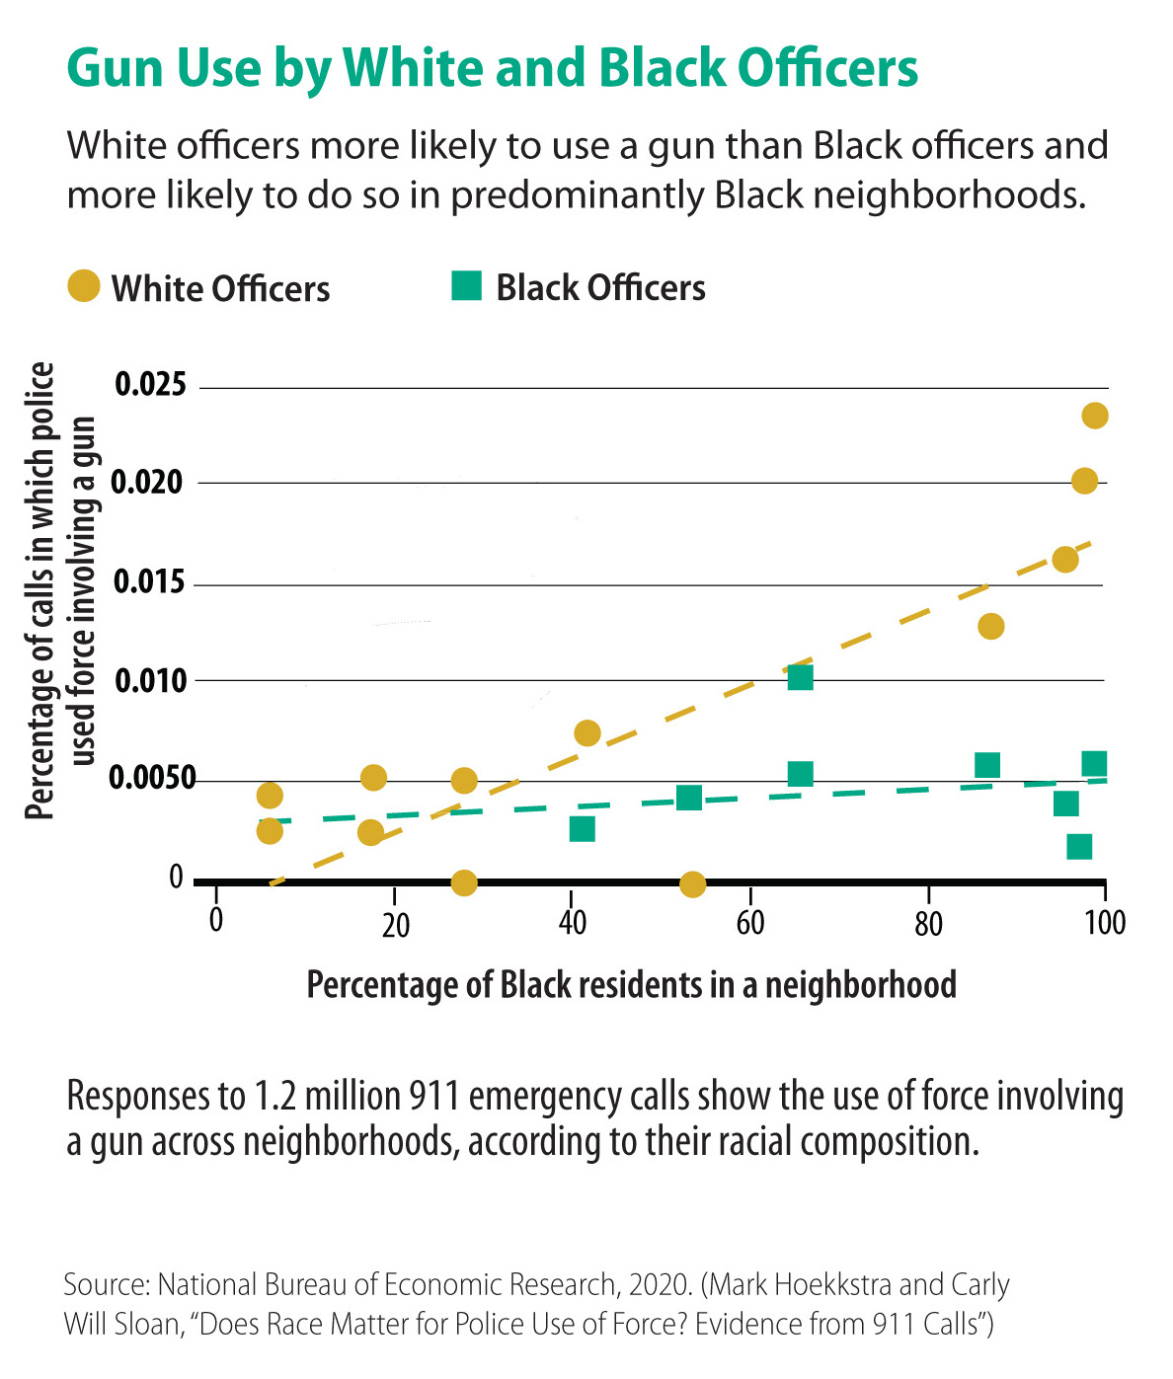

Slide 6
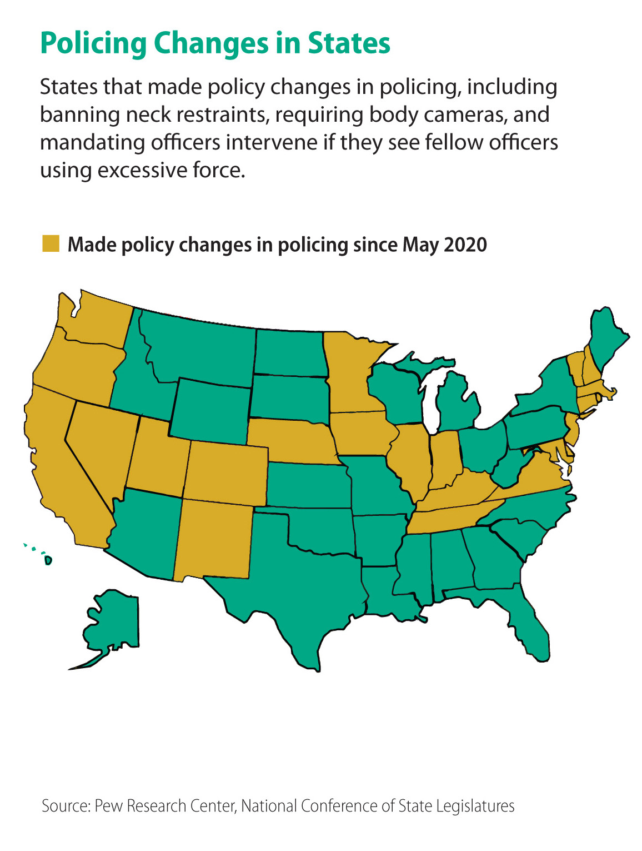

Slide 7
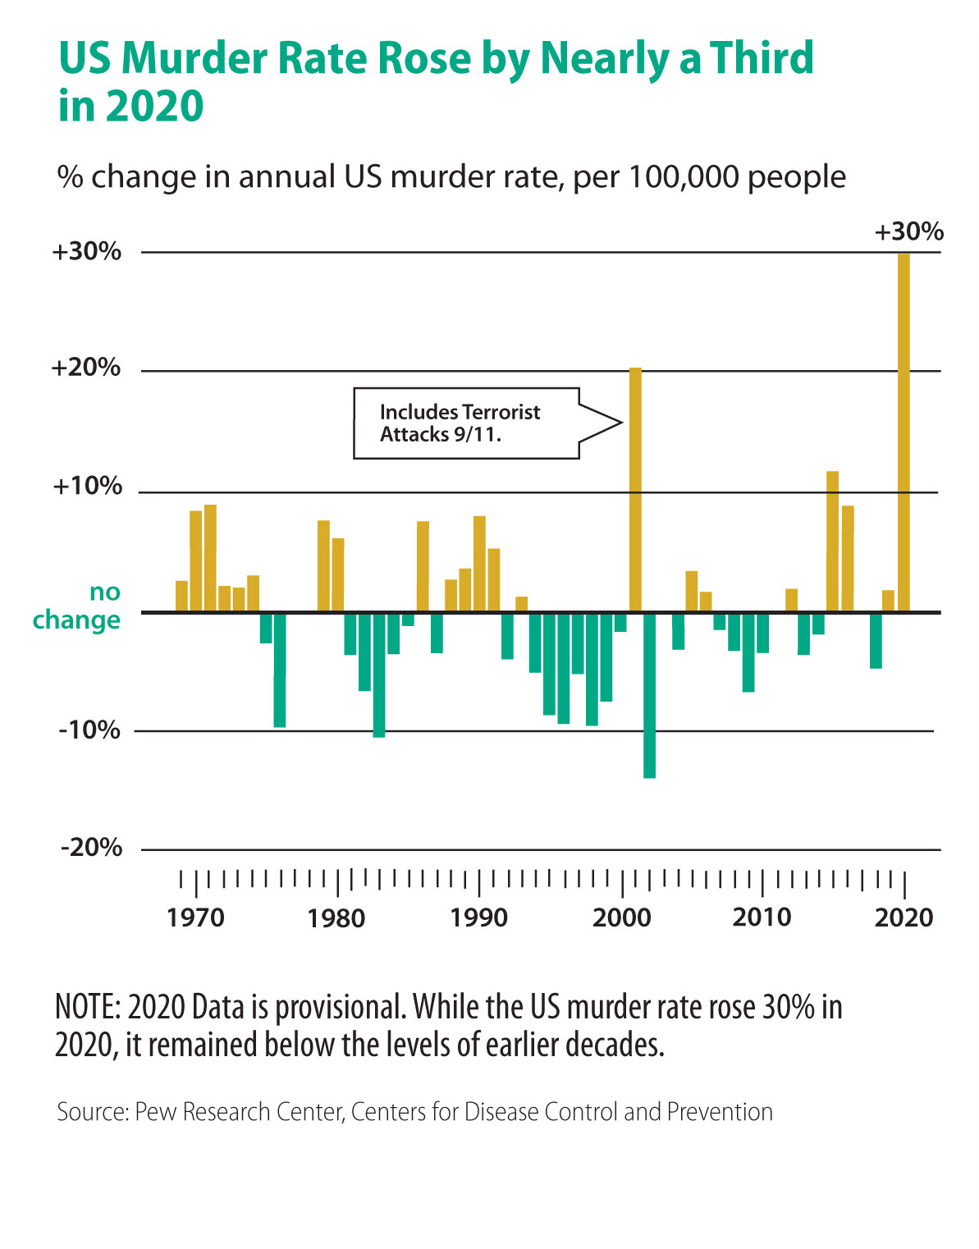

Slide 8
Guidelines for a Forum
Focus on the options and actions we can take nationally and in our communities.
Consider all options fairly.
Listening is just as important as speaking.
No one or two individuals should dominate.
Maintain an open and respectful atmosphere.
Everyone is encouraged to participate.
Are their additional guidelines we would like to add?

Slide 9
OPTION 1:
Make rigorous accountability the top priority
To ensure safety and justice for all, we need well-trained, thoughtful, and accountable police officers who do not rely solely on force and intimidation and treat everyone respectfully.
We need to make all officers more answerable for their conduct and hold them to the highest standards.
We should rethink the ways in which police officers are hired, trained, supervised, and disciplined.
We need to ensure that officers who are abusive do not continue to police the streets.
A Primary Drawback
  Very few of us understand the dangers and complications officers face daily, and constant second-guessing and monitoring may lead the police to be less vigilant than we need them to be. We should enforce the accountability measures we have now, but there is no need to keep adding to them.
This option says
that we all want to live in law-abiding communities.

Slide 10
Option 1: Make rigorous accountability the top priority
Things We Might Do
Drawbacks
Make police disciplinary records available in a public database so journalists and community members have access to them and officers with repeated complaints won’t be hired elsewhere.
Officers who are falsely accused and cleared of charges may have their careers ruined and be publicly and unfairly smeared.
Fire officers who fail to report suspected police misconduct; reward and promote those who do.
This could create an atmosphere of antagonism and snitching among officers who need to trust each other and work together. It could easily be misused for all sorts of reasons.
Create diverse, multiracial, and independent civilian review boards that can investigate complains from the public and recommend an officer’s removal if warranted.
Reviews of police behavior should be conducted by those who understand the job firsthand. Civilian boards can inject too much partisanship and emotion into the process.
Congress should broaden the ability for people to sue individual police officers for physical abuse and mental stress.
This may result in more frivolous lawsuits. Moreover, the threat of being sued could lead to officers being hesitant to act at crucial times.
Require police officers to wear body cameras, turn them on during every encounter with the public, and release the full recordings to the public when there are charges of police misconduct.
Body cameras do not automatically increase police accountability, or reduce the use of force by officers, and people are concerned about increased surveillance and invasions of privacy when sensitive moments are recorded and later made public.
What else could we do, especially as a community?
What’s the drawback if we do that?

Slide 11
Make rigorous accountability the
top priority
1
This approach proposes rigorous oversight of police by civilian review boards. Thinking of your own community, could there be too much civilian oversight of the police? Is there a danger of politicizing and undercutting law enforcement? Why or why not?
OPTION 1
Questions for deliberation
2
One proposal for this option is to make it easier to sue individual police officers for misconduct. Would this be an effective way to deter officers from using abusive and violent tactics? Why or why not? Do you think this might lead to frivolous lawsuits against officers who were only doing their jobs?

Slide 12
OPTION 2:
Make ending racial bias the top priority
Police violence and bullying, and routine suspicion of certain groups of people, are not confined to a few rogue officers.
Law enforcement’s traditions and operating assumptions tend to excuse White Americans and penalize those from other backgrounds.
If we do not deal with widespread racial discrimination and biased thinking among police officers and the bias embedded in the way they do their jobs, abusive policing will continue.
A Primary Drawback
  We should fire officers who abuse and mistreat citizens, but we shouldn’t assume that most officers are racists. By stereotyping all officers and entire departments, we do a disservice to the officers who treat citizens with respect, support reforms, and work to end misconduct.
This option says
law enforcement agencies, like other institutions, reflect this country’s history of persistent racial discrimination and injustice.

Slide 13
Option 2: Make ending racial bias the top priority
Things We Might Do
Drawbacks
Overhaul police education programs to make training about bias, or racial prejudice, equally as important as weapons training so officers have the knowledge and skills necessary to successfully engage the communities they serve.
There are no guarantees or solid evidence that diversity, equity, and inclusion trainings change officer behaviors or department culture. Police are not responsible for solving social problems and training should focus on finding and arresting criminals.
Conduct background checks to determine if a potential officer has a history of displaying racial bias.
Racist feelings and discriminatory behaviors are sometimes unconscious or hidden and will not be discovered during a background check.
Require officers to live in the communities they serve so they develop respect for diverse residents and strong ties to all the people they serve.
This will limit the number of people entering policing, and unless we are willing to pay officers more, many won’t be able to afford to live in the communities they serve.
Diversify the police force by recruiting and retaining officers of various backgrounds.
A diverse force will not automatically end racial bias or the mistreatment of certain marginalized groups at the hands of police.
Permit the U.S. Justice Department to investigate and take over police departments where there is a pattern of racist practices and racially biased enforcement.
Federal intervention can lead to a loss of local control or community oversight and it can strain the resources of local departments that have to meet court-approved benchmarks for accountability.
What else could we do, especially as a community?
What’s the drawback if we do that?

Slide 14
Make ending racial bias the top priority
1
Police officers often make split second decisions in confusing, dangerous situations. Would more racial justice and de-escalation training reduce police errors? Or could it end up jeopardizing officers and public safety because the police are more hesitant?
OPTION 2
Questions for deliberation
2
One proposal for this option is to require officers to live in the communities. Would this improve their relations with residents? Would it deter officers from taking jobs in troubled areas? Is it fair? Most of us have choices about where we live. Shouldn’t police officers have that too?

Slide 15
OPTION 3:
Make avoiding violent encounters the top priority
Studies show that nine out of 10 calls for service are for nonviolent encounters.
Police are asked to deal with problems that go beyond what they should be responsible for and what they were trained to do.
Many communities lack resources for addressing mental health crises, drug abuse cases, and domestic disputes, so these jobs fall to police.
These nonviolent offenses are better addressed by skilled mental health advocates or sometimes members of the community.
We should hire more social workers and community service officers to address social ills and nonviolent crime so police can focus on violent crime.
A Primary Drawback
  Drug abuse, mental health problems, domestic disturbances, and civil infractions often escalate into violence, and, without backup support, the lives of counselors, social workers, and civil enforcement officers are threatened. We must recognize that armed police restore order in chaotic situations and without their presence being felt in neighborhoods many people may become victims of drug and gang violence, spousal abuse, and petty crime.
This option says
we have left it to the police to respond to social problems and have never fully considered whether there are better alternatives.

Slide 16
Option 3: Make avoiding violent encounters the top priority
Things We Might Do
Drawbacks
Increase training in de-escalation and teach officers to draw their guns less often.
With so many guns in our communities, this could put police officers and the public at greater risk.
Respond to domestic disturbances with teams of social workers, mental health professionals, and drug counselors who can get involved before situations escalate.
Domestic abuse is violent, and perpetrators should be reported to the authorities and arrested immediately. Without jail time as a deterrent, the cruelty will continue.
Hire more unarmed public safety professionals, like parking enforcement officers or traffic wardens, to enforce traffic laws and other minor violations.
Without police involvement or the treat of arrest, potentially violent or volatile situations can endanger the lives of first responders.
Provide more counseling for law enforcement officers and other first responders to help them handle the pressures of the job.
Counseling is not a cure-all. The people who most need it often do not pursue it.
End arrests and ticketing for marijuana possession and other low-level offenses like prostitution, solicitation, trespassing, public urination, and shoplifting.
Over time this will lead to increased lawlessness and more unsafe public spaces in our communities.
What else could we do, especially as a community?
What’s the drawback if we do that?

Slide 17
Make avoiding violent encounters the top priority
1
This option proposes decriminalizing some “non-violent” offenses such as marijuana possession, prostitution, solicitation, trespassing, and public urination. How would this approach affect downtown areas, malls, and parks? What should happen to those who commit these offenses repeatedly if they cannot be arrested or ticketed?
OPTION 3
Questions for deliberation
2
Thinking of your own community, do you think it’s a good idea to shift funds from the police department to fund more mental health services? Do you believe your community has enough trained mental health professionals and mental health services to take on these tasks?

Slide 18
CLOSING REFLECTIONS
  Now that we have deliberated, are there ideas or viewpoints you hadn’t considered before?
  Have your priorities shifted as a result of this deliberation? In what way?
  Can you now identify any shared concerns or hopes we have discovered in our deliberations?
  Can you identify any potential unintended consequences that came up during the forum?
  What questions remain? What work do we still need to do? Who else do we need to talk to?
  What could you do as an individual? What could the community do? What should we expect from our elected officials at the local, state, and national level?
Other questions
to consider

Slide 19
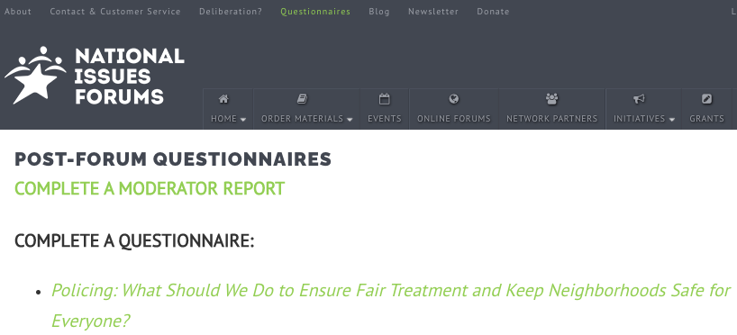
Post Forum Response Survey
Now that you’ve had a chance to participate in a forum on policing, we’d like to know what you’re thinking. Anonymous responses will be included in summary reports on the forums to help us better understand how people are thinking about this issue.
Please complete the post-forum response survey online to share
your insights.
THANK YOU!

