Slide 1

WELCOME
National Issues Forums
on
Youth and Opportunity
[insert date]

Slide 2
Holding a Deliberative Forum
1. Introduction
2. Connect to Issue
3. Consider Each Option
4. Review and Reflect
Review ground rules.
Introduce the issue.
Ask people to describe how the issue affects them, their families, or friends.
Consider each option one at a time.
Allow equal time for each.
What is attractive?
What about the drawbacks?
Review the conversation as a group.
What areas of common ground were apparent?
What tensions and trade-offs were most difficult?
Who else do we need to hear from?

Slide 3
Ground Rules for a Forum
Focus on the options and actions we can take nationally and in our communities.
Consider all options fairly.
Listening is just as important as speaking.
No one or two individuals should dominate.
Maintain an open and respectful atmosphere.
Everyone is encouraged to participate.

Slide 4
DISCUSSION STARTER VIDEO
Link to discussion starter video

Slide 5
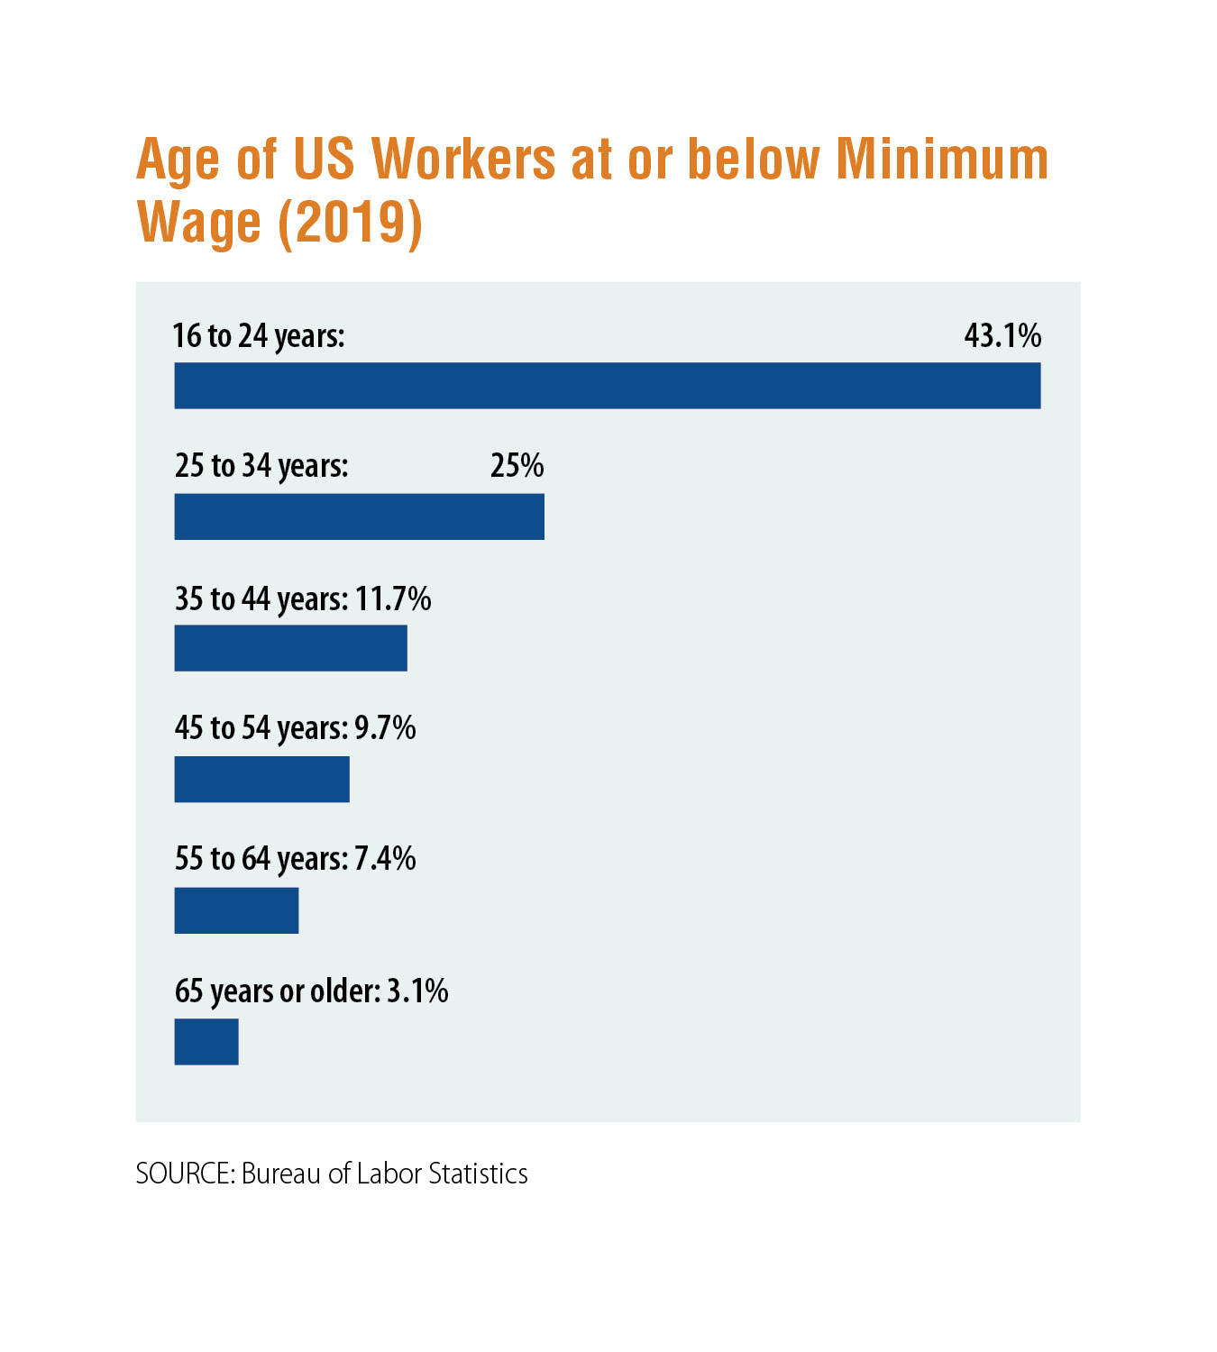
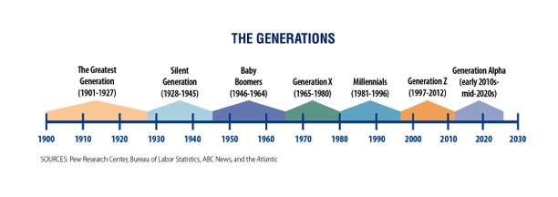

Slide 6
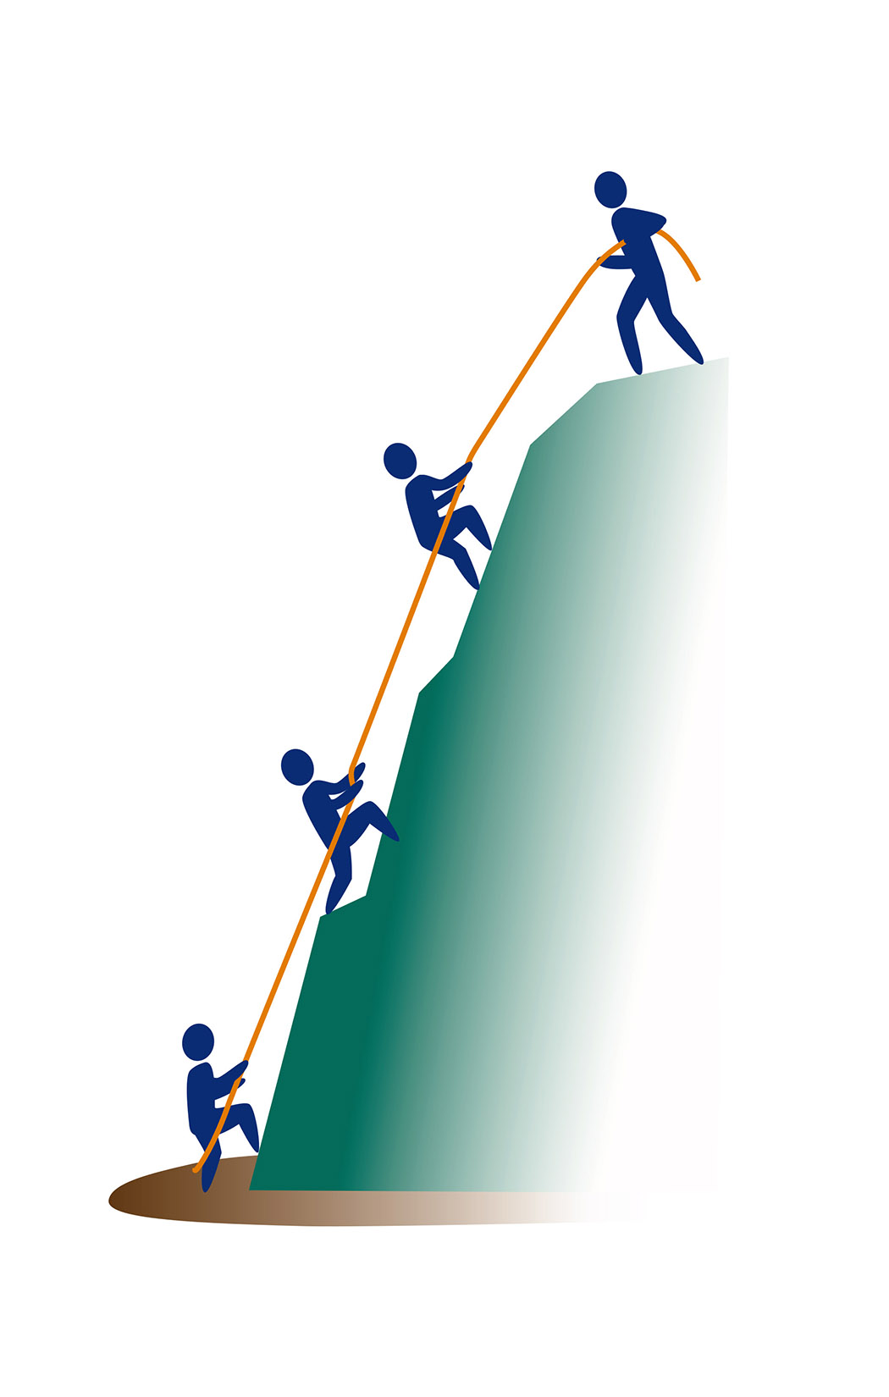
OPTION 1:
Equip People to Succeed
We must rethink what it means to prepare young people for a vastly different social and economic landscape through the rest of this century.
The global economy is fueling competition, while automation is shrinking the number of jobs.
A greater share of the jobs that remain will require a college degree or other advanced training.
A Primary Drawback
  This does too little to teach self-reliance, personal responsibility, or a good work ethic and assumes that all challenges can be overcome with more services. But even the best preparation doesn’t ensure success in life. There are many forces that determine our individual and collective futures.

Slide 7
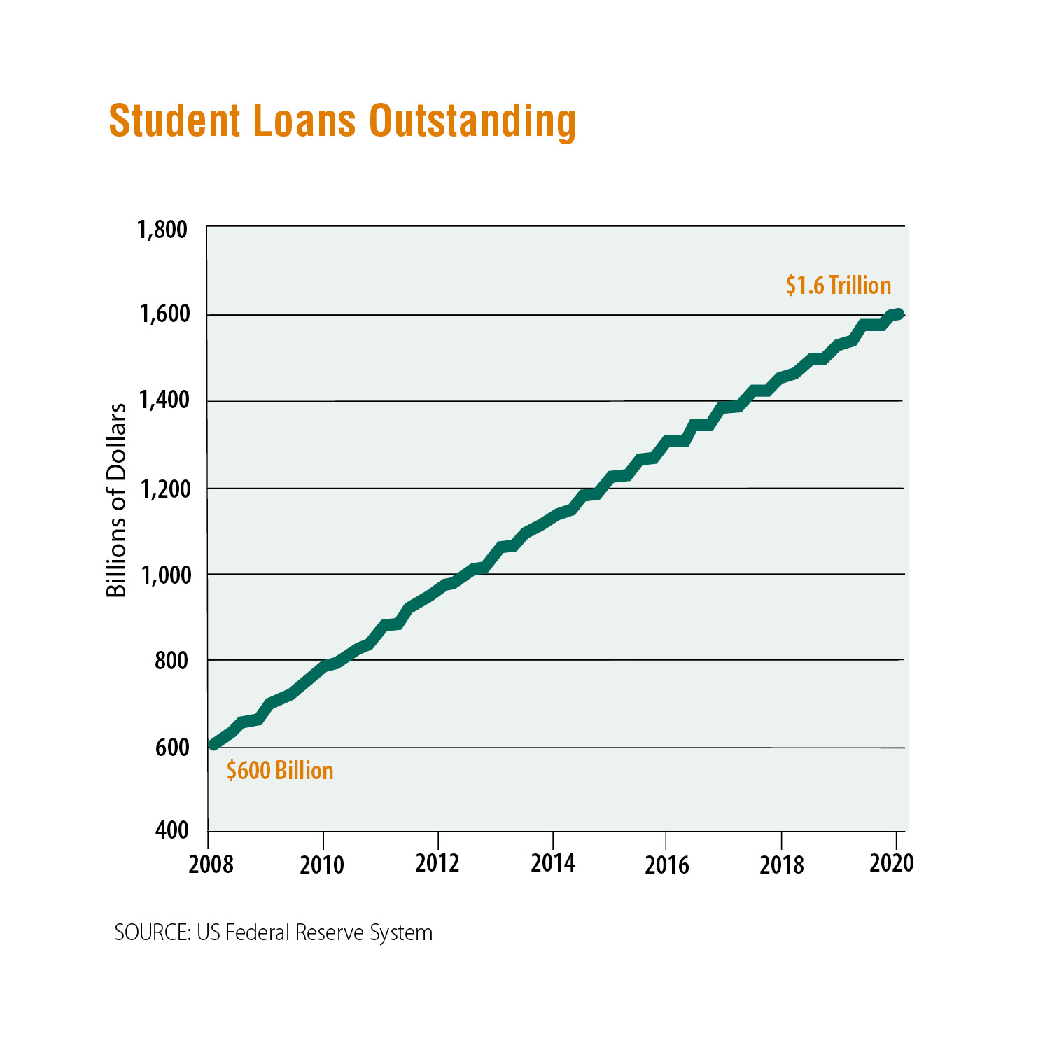

Slide 8
Option 1: Equip People to Succeed
Actions
Drawbacks
Boost K-12 student achievement by reducing
class sizes and providing extra support to students who need it.
This would require more teachers and increases in school district budgets and property taxes.
Allow students to have student loan debt canceled if they complete a year of national service in underserved communities.
More affluent young people will bypass national service while middle and working class students lose a year in the pursuit of their career goals.
Greatly expand mentorship and internship programs where engaged adults will expose young people to the work skills that jobs require or encourage them to complete their schooling.
Companies rarely design high-quality internship programs, and internships, which often pay little or nothing, typically go to children of privileged families who can afford them.
Increase services and resources for mental health and well-being to increase chances that young people can take advantage of their opportunities.
If we medicalize every problem, we won’t be teaching young people about how to be resilient and self-sufficient.
What else could we do?
What’s the trade-off if we do that?

Slide 9
1
Reducing class sizes, forgiving college debt, and expanding mentoring and mental health services will not be free. Where should the money come from? In your own community, what kinds of tax increases or cuts in service would you support in order to pay for these proposals?
OPTION 1
Questions for deliberation
2
Are large class sizes and lack of extra support the most crucial problems in education? What about improving teacher training or efforts to retain good teachers in substandard schools or raising standards?
3
Is eliminating student loan debt fair to students and families who save for college or to students who work their way through college, choose to go part time, or choose less expensive schools in order to keep their debt to a minimum?

Slide 10

OPTION 2:
Give Everyone a Fair Chance
Entrenched biases toward race, religion, gender identity, and sexual orientation have created an uneven playing field.
This not only unjustly creates serious barriers for millions of young people but also deprives society of the contributions many of them would have made if they had access to the same opportunities enjoyed by their more fortunate peers.
A Primary Drawback
  Even policies that mandate equitable treatment cannot eradicate bias or change the hearts and minds of citizens. Affirmative action policies, intended to help level the playing field, have often been seen as “reverse racism” that limits opportunities for White Americans.

Slide 11
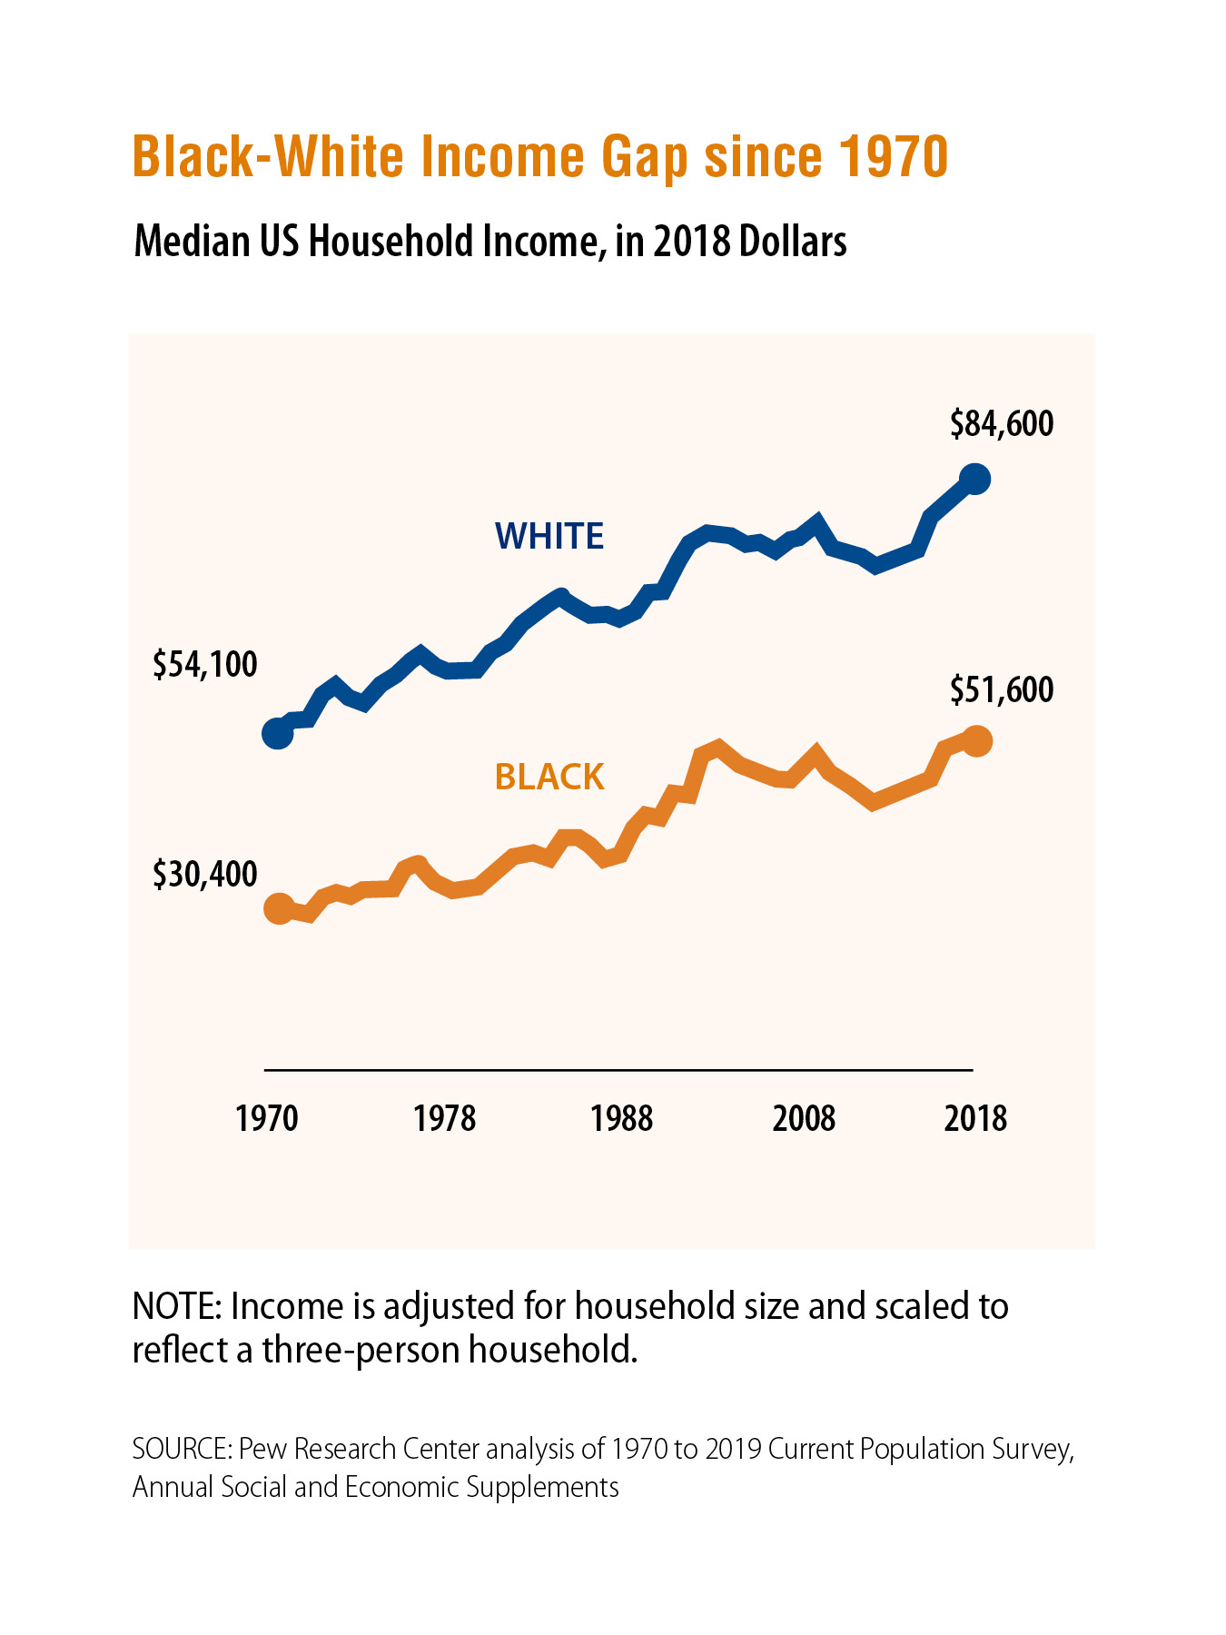

Slide 12
Option 2: Give Everyone a Fair Chance
Actions
Drawbacks
Increase the minimum wage to improve household incomes and reduce child poverty.
This will put some small companies out of business, reducing jobs rather than increasing them.
Eliminate standardized testing, which disadvantages minority students, and instead, assess students through teacher evaluations.
Standardize tests give essential information about students’ reading, math, and knowledge levels. Individual teachers may have low standards or favor students they like.
Make community college free, and guarantee that students could then enter four-year colleges.
Not everyone who completes community college is ready for a four-year institution. This will make some colleges less selective.
Make K-12 US history curricula more inclusive by acknowledging the contributions and experiences of slaves, immigrants, and indigenous peoples.
This will require lots of retraining and will be a major change, possibly at the expense of important American concepts. History teachers can barely get through the basics as it is.
What else could we do?
What’s the trade-off if we do that?

Slide 13
1
Can legislation and other policy changes really reduce bias? If not, what would?
OPTION 2
Questions for deliberation
2
How far would raising the minimum wage go in reducing child poverty? Is it a major step forward or only a minor one? What other changes might be more important?
3
If we eliminate standardized tests in K-12 schools, should we eliminate them in licensing for professionals such as doctors, lawyers, and accountants? Do standardized tests have any benefits in our society?

Slide 14

OPTION 3:
Focus on Economic Security
Our rising national debt has put our country on an unstable footing, limiting our ability to invest in future growth or tackle present challenges.
We cannot make progress on other fronts if we don’t address the problems that threaten to bankrupt us.
We need to increase and sustain our efforts to leave a more secure economy for future generations.
A Primary Drawback
  Partisan gridlock often hinders efforts to craft and pass legislation that addresses perennial problems. By the time these issues are attended to, today’s youth will be retirement age.

Slide 15
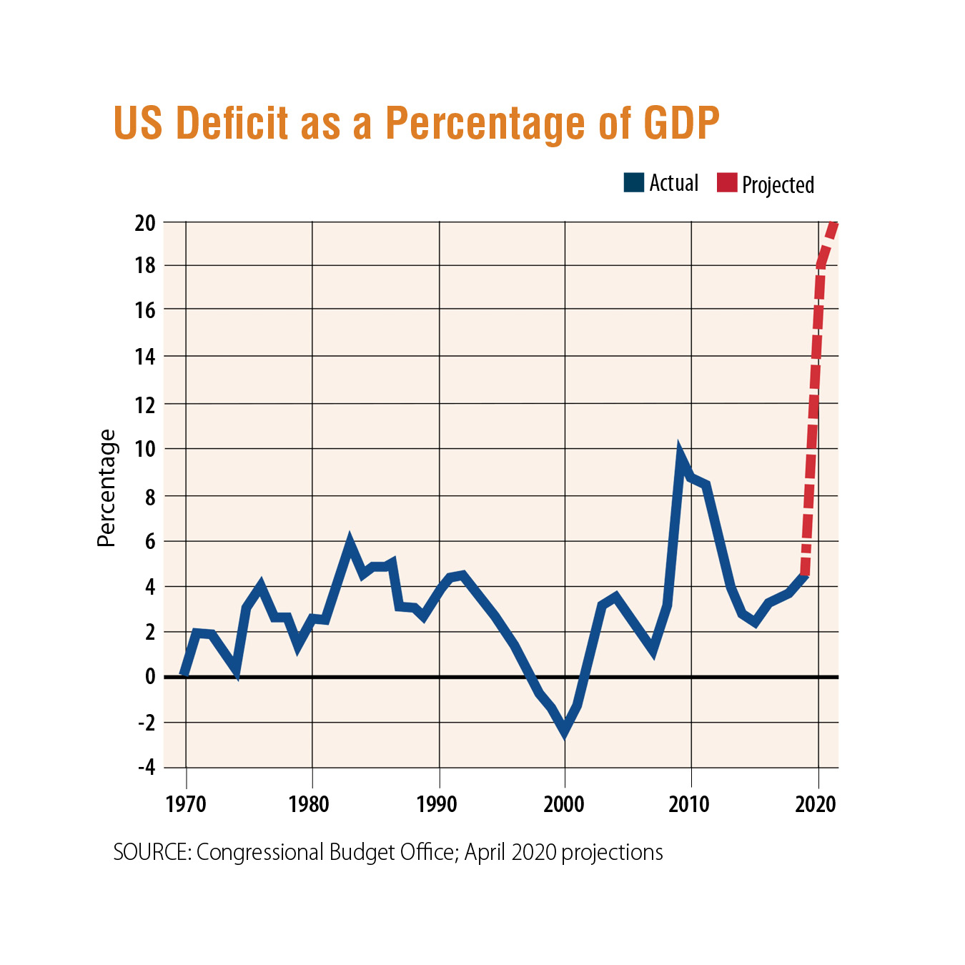

Slide 16
Option 3: Focus on Economic Security
Actions
Drawbacks
End deficit spending and begin containing the federal debt.
This would require across-the-board cuts in needed programs and force tax hikes that will extend the current economic recession rather than shorten it.
Local utilities should invest in switching to renewable energy sources to combat climate change and create opportunities for clean jobs.
Utilities will likely have to raise consumers’ rates, which hurts low-income families and small businesses.
Invest in building and repairing roads, bridges, and other infrastructure.
Major investments like this would add to our national debt, require higher taxes to fund projects, or divert funds from other needed programs.
Cities and counties, as well as consumers, should do business only with companies that hire American workers and build factories in the US.
This will increase prices on food and consumer goods, limit buyers’ choices, and could lead to shortages and less international trade.
What else could we do?
What’s the trade-off if we do that?

Slide 17
1
States and communities nationwide are suffering from the pandemic and the economic downturn it has brought. Is it realistic to end deficit spending now?
2
The country was running deficits even when the economy was thriving because raising taxes, cutting spending, or doing both upsets voters. What specific spending would you be willing to cut? Would you be willing to cut any spending that you typically support?
OPTION 3
Questions for deliberation
3
Is it possible or even wise to try to keep all American factories open and protect all American manufacturing jobs? Could this have unintended consequences? What might go wrong if we pursued this policy fully?
4
Whose jobs will be replaced or displaced by the transition to renewable energy sources, and how should we retrain them?

Slide 18
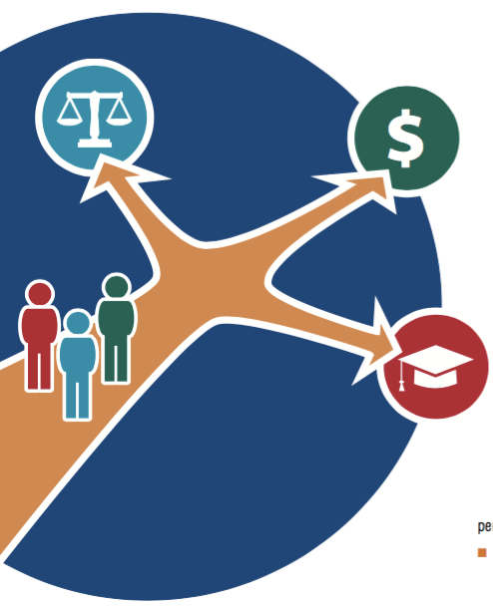
Closing Reflections
Other questions to consider—
On what do we agree?
About what do we need to talk more?
From whom else should we hear?
What else do we need to know?
How do the ideas and options in this guide affect what we do as individuals or as members of a community?
How might our actions affect the nation in the future?

Slide 19
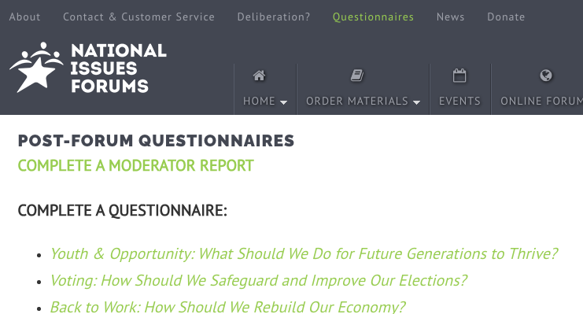
Post Forum Questionnaire
Now that you’ve had a chance to participate in a forum on this issue, we’d like to know what you’re thinking. Anonymous responses will be included in summary reports on the forums and in research to help us better understand how people are thinking about current issues.
You may fill out this questionnaire online. https://www.surveymonkey.com/r/youthandopportunity.
THANK YOU!

